Slide 1

Architecture & Design
Education / Careers / Profession
Ronald C. Weston, AIA
Vice President at PS&S Architects & Engineers
2018 President at AIA Newark & Suburban Architects

Slide 2
ABOUT TODAY
What I hope to accomplish
Give you some information about me
Introduce reasons to consider becoming an architect
Convey the importance & impact of good design
What you can study to prepare for architecture school
Discuss the education path towards becoming an architect
Outline design and construction process & tools
Introduce allied design & engineering fields
End with questions & discussion

Slide 3

Architect: [ahr-ki-tekt] noun
A person who engages in the profession of architecture.
A person professionally engaged in the
design of certain large constructions other than buildings and the like: landscape architect; naval architect.
3. The deviser, maker, or creator of anything.

Slide 4
REASONS
to become an Architect
You get to see your work built
You can positively affect people’s lives
So….. you can make the world a better place
It is a diverse, changing and creative profession
Architecture is a respected profession

Slide 5


Architecture
can make places special
The Coliseum in
Rome, Italy
AT&T Stadium
Dallas, TX

Slide 6


Architecture
can make places special
New York Towers
Eiffel Tower

Slide 7


Architecture
can make places special
Rockefeller Center
Architect: Raymond Hood
The Center at Christmas time

Slide 8


Architecture
can make places special
The Disney Castle
Neuschwanstein Castle
the inspiration for the Disney Castle

Slide 9
WHAT you can study to prepare for Architecture School
Art, Drafting and Drawing
Photography
Graphic Design & Gaming Software Applications
Math (Geometry & Trigonometry)
Science (Physics & Materials)
Social Studies & History

Slide 10
HOW
do you become an Architect
College Degree in Architecture –
  5-year Accredited Bachelor of Arch Degree
  Bachelor Degree + 2-year Master of Arch Degree
Gain work experience
  Intern / Apprentice for 36 months
  NCARB AXP experience hours
Take and pass a state licensing exam
  NCARB ARE Exam
  State Boards of Architecture issue license

Slide 11
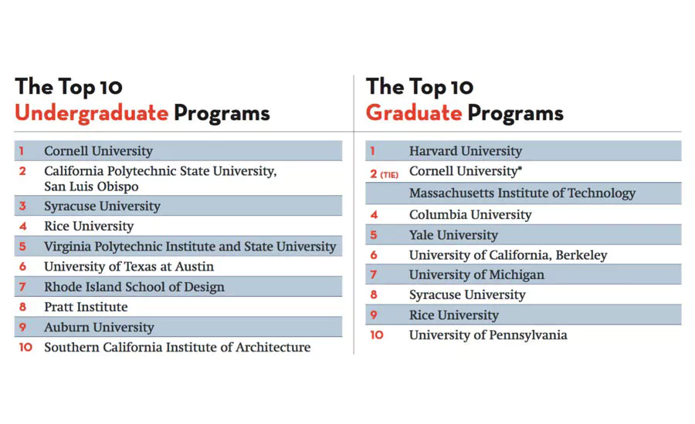
U.S. Schools of Architecture (2017)
Source: 2017 Design Intelligence

Slide 12
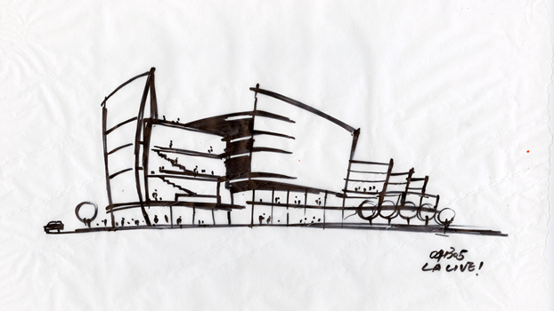
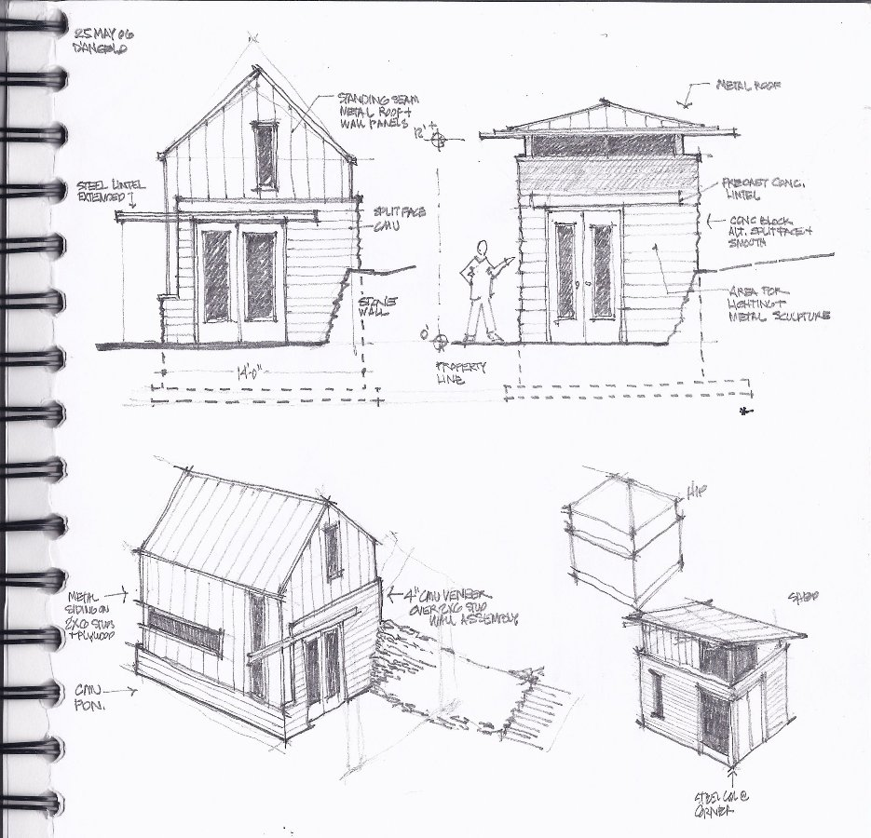
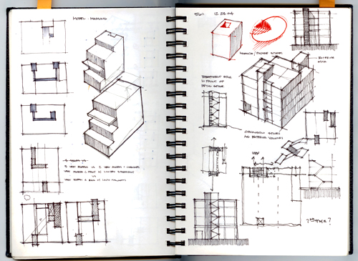
The ARCHITECTS Vision
Starts with Drawings & Sketches

Slide 13
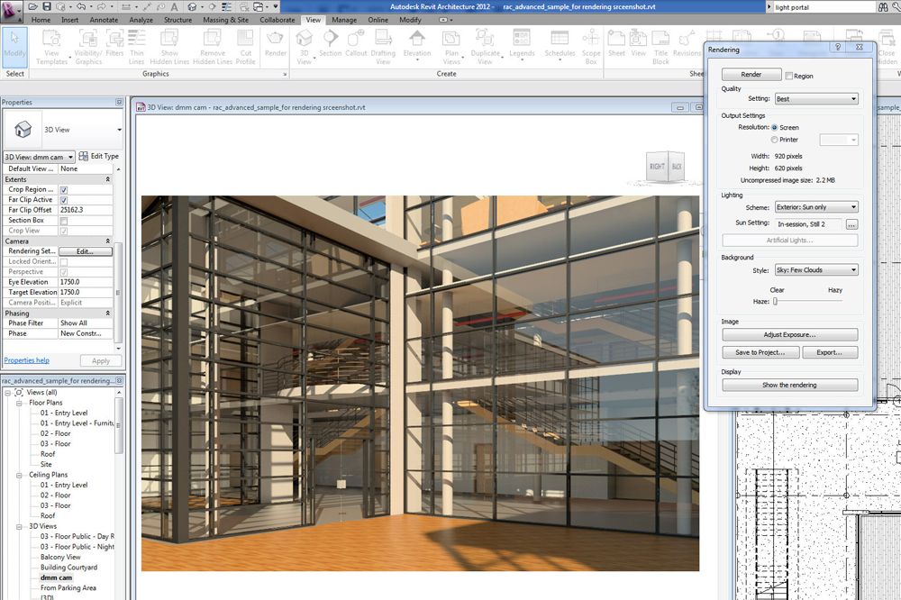
ARCHITECTS NEW DESIGN TOOLS:
CAD & Building Information Modeling

Slide 14
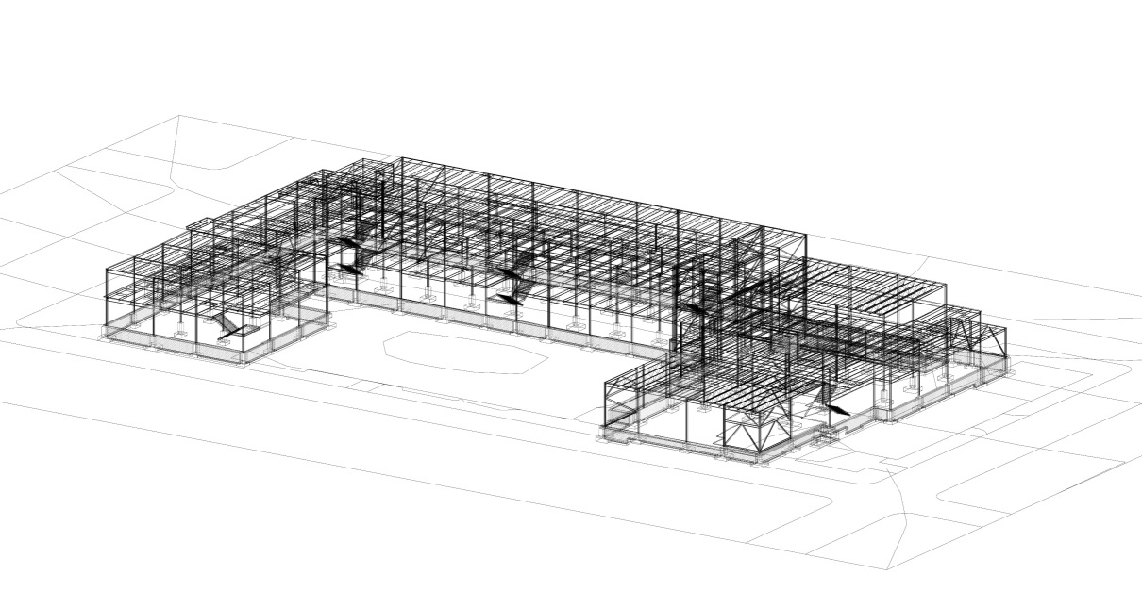

ARCHITECTS NEW DESIGN TOOLS:
CAD & Building Information Modeling
Structural Model
Mechanical, Electrical and Plumbing Models

Slide 15

ARCHITECTS NEW DESIGN TOOLS:
CAD & Building Information Modeling

Slide 16
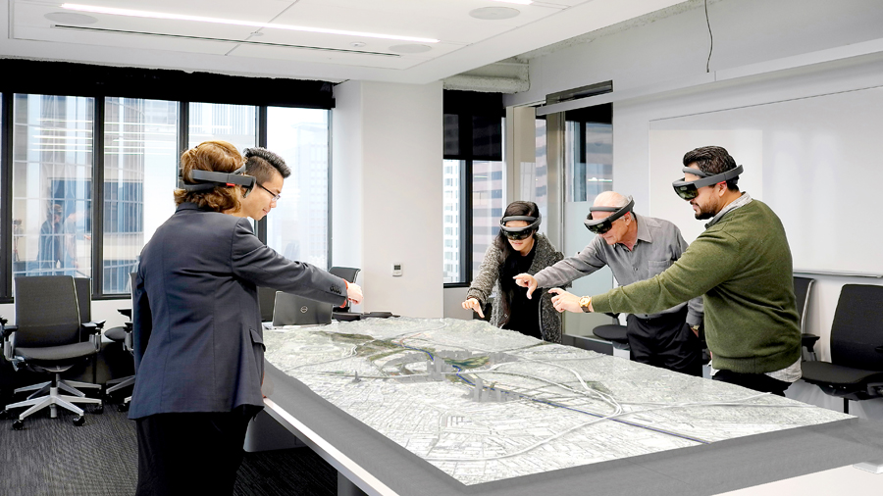



ARCHITECTS NEW DESIGN TOOLS:
3D Virtual Reality (Oculus Rift)

Slide 17
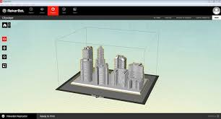


ARCHITECTS NEW DESIGN TOOLS:
3D Printed Models (MakerBot)

Slide 18
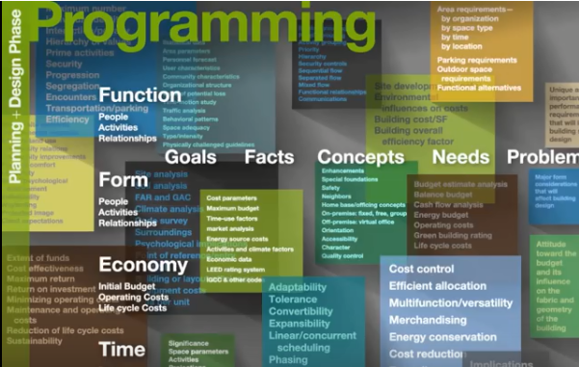

Slide 19


Slide 20
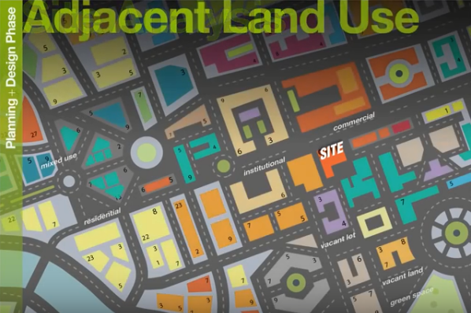

Slide 21
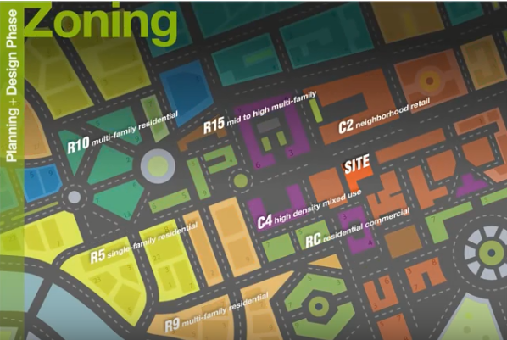

Slide 22
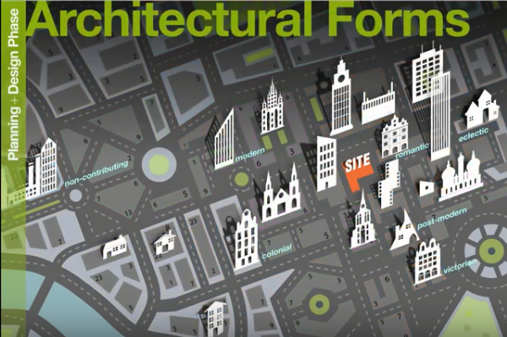

Slide 23
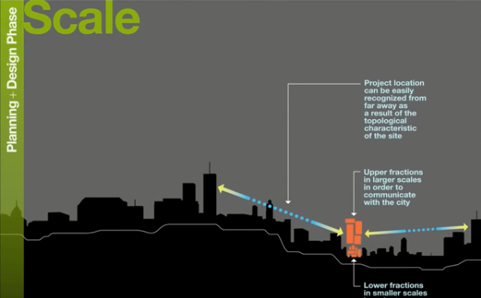

Slide 24


Slide 25


Slide 26


Slide 27


Slide 28
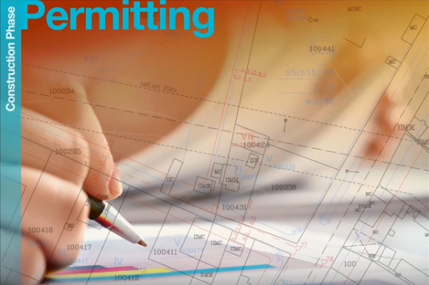

Slide 29


Slide 30
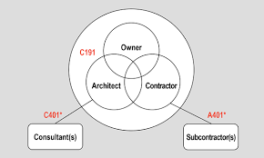
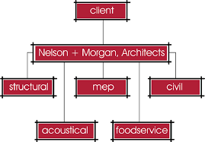

Slide 31
Architect cross-over careers:
Interior Designer
Urban Designer / City Planner
Landscape Architect
Product or Lighting Designer
Lighting Designer
Acoustic Designer
Kitchen Designer
Real Estate Developer
Builder / Construction Manager

Slide 32
Building Engineering Disciplines
Civil Engineers
Structural Engineers
Mechanical Engineers (HVAC & Plumbing)
Electrical Engineers
Fire Protection Engineers

Slide 33

VIDEO LINK 1: Look Up https://www.youtube.com/watch?v=FS3_LKot7J0

Slide 34

VIDEO LINK 2: Look Up to America’s Future https://www.youtube.com/watch?v=FS3_LKot7J0

Slide 35
Questions
?
Discussion
Ronald C. Weston, AIA
Vice President at PS&S Architects & Engineers
2018 President at AIA Newark & Suburban Architects

