Slide 1
Point Pleasant Beach High School Career Day
Verity L Frizzell, FAIA
2018 President, AIA New Jersey
Principal, Feltz & Frizzell Architects, LLC
Notes:
Hi and thanks for allowing me to join you in class today. My name is Mrs. Frizzell and I am an architect here in Point Pleasant and President of the NJ Chapter of the American Institute of Architects. The American Institute of Architects is the professional organization that helps architects serve the public’s needs and builds awareness of the role of architects and architecture in society.

Slide 2
What is an architect ?
An architect is a qualified professional who designs and supervises the construction of buildings or other structures.
Who can be an architect ?
Notes:
Can anyone tell me what an architect does?
An architect is a qualified professional who designs and supervises the construction of buildings or other structures.

Slide 3

Everyone can be an architect!
Notes:
And who can be an architect?
ANYONE and EVERYONE can be an Architect
Some of the skills that are important to have are spatial awareness and the ability to think in three dimensions. You have to be able to see the building you are creating in your mind’s eye. The tools you will use in your career are software programs that help you draw. Some are better in two-dimensions and others draw models of your building. I started out drawing with a pencil on paper, and transitioned to 2D computer drafting. I am working on learning 3D software, but I’m not there yet. You are likely to learn both in school.
You will need to know math and science to understand the structure and dynamics of the building.
Material science and building performance are becoming increasingly important as we design buildings to be more energy and resource efficient.

Slide 4
What does an architect do?
Solves Problems
Draws Pictures
Uses a Computer
Goes to Meetings
Measures Buildings
Makes Presentations
Builds Models
Designs Buildings
Meets with Clients
Talks to Code Officials
Notes:
You may have heard of an architect, but I wonder if you know all the things an architect does in a typical day…(click through each item one at a time)
Solves Problems
Draws Pictures
Uses a Computer
Goes to Meetings
Measures Buildings
Makes Presentations
Builds Models
Designs Buildings

Slide 5

How do you become an architect ?
Notes:
To practice as an architect, you must earn a license. The path to licensure is ever changing, but the traditional way of becoming an architect in NJ is administered by the National Council of Architecture Registration Boards (NCARB), which sets the requirements for exam preparation.
You must finish high school, go to college, get work experience, and take a series of exams.
Once you complete all that, you can be registered with your state board of architects and begin practicing on your own.

Slide 6

Earn a high school diploma
Notes:
The first step is to finish High School. Some of the classes which will serve you well in your career path are art, physics, and calculus. If it is available, drafting or architecture classes. Some schools have AutoCAD, which is one of the many Computer Aided Design programs that architects use. It’s also good to know how to write, so literature classes where you write papers are a good idea.
My middle school had mechanical drawing, and my high school offered architecture classes. I also took AP Physics & AP calculus, and English lit.

Slide 7
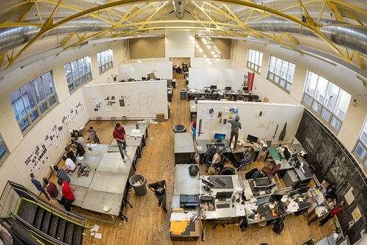
Go to college
Notes:
Earn a Professional Degree from one of over 150 accredited programs at 120 institutions. There is an organization called the National Architecture Accreditation Board (NAAB) which reviews programs at each university to make sure they meet certain standards. If they do, they become “accredited” and the education you receive there can be used toward your license.
I chose the 4+2 path and earned a 4-year Bachelor of Science in Architecture degree from the University of Virginia, and a 2-year Master of Architecture degree from the University of Texas at Austin. Princeton University has a 4+2 program as well.
Alternatively you can earn a 5-year Bachelor of Architecture degree from any of a number of universities like NJIT or Kean.
School will teach you design thinking, structures, history, theory, and how to draw.

Slide 8

Get a job
Notes:
Get practical Work Experience – Current NCARB program includes 3,740 hours in 6 areas of practice. You work under the supervision of a licensed architect and learn everything you need to know about the business of architecture, as well as how to produce a set of plans. You will go into the field and observe construction, check shop drawings, meet with clients, and do design work.

Slide 9

Take the exam
Notes:
The architect registration exam (ARE) features 6 divisions organized around the progression of a typical architecture project:
Practice Management
Project Management
Programming & Analysis
Project Planning & Design
Project Development & Documentation
Construction & Evaluation
The exam is taken at testing centers on a computer. You take the exams at your own pace, and can re-take parts you don’t pass.

Slide 10

Get a license!
Notes:
Once you do all that, you get your license. Each state has a State Board of Architects which issues the licenses. New Jersey currently requires a raised seal for drawings being submitted for a building permit. When you affix your seal to the drawings, you are taking responsibility for them and certifying that they meet the current building codes and local zoning ordinances.

Slide 11
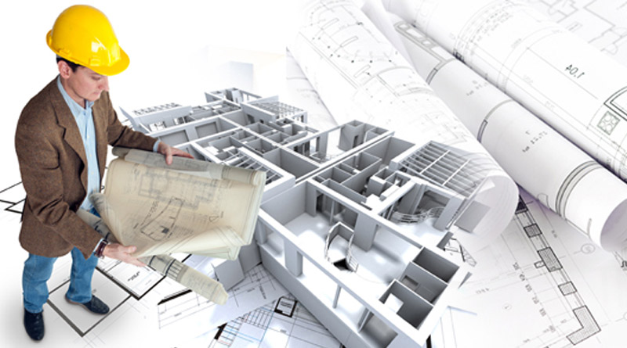
Architectural projects have 6 phases
Notes:
Similar to the exam, an architectural project has 6 phases:

Slide 12
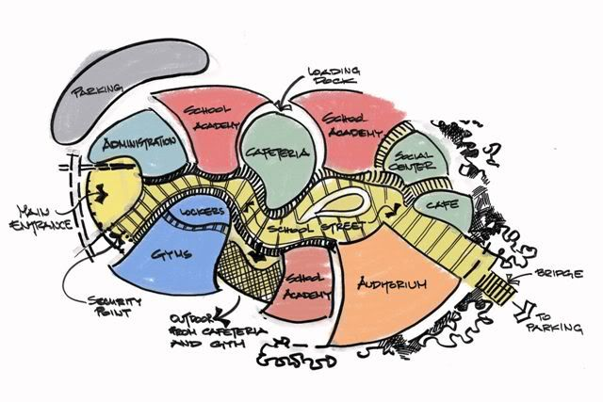
Programming
Notes:
- Programming - where you sit down with the client to go over what they want from the project

Slide 13
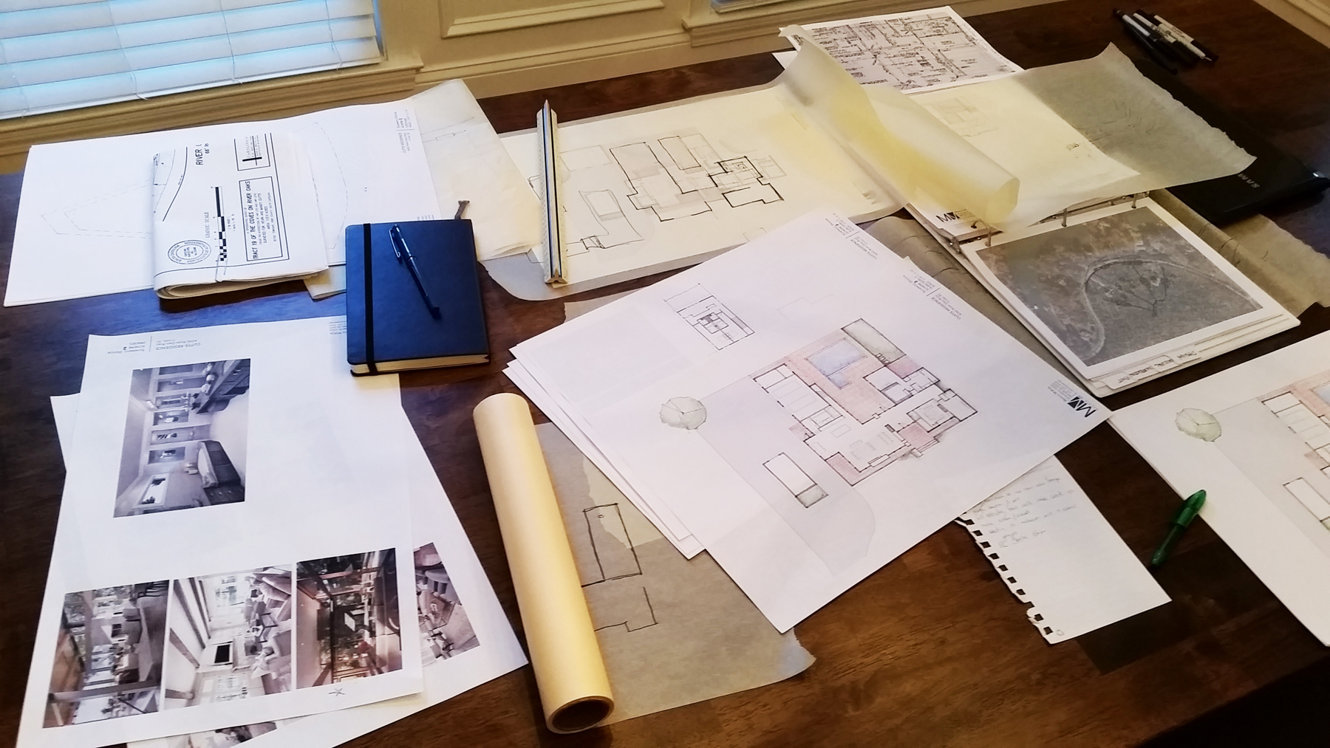
Schematic Design
Notes:
Schematic Design – where you evaluate the site and begin conceptual designs. This phase can go through many iterations before the client is happy with the design

Slide 14

Design Development
Notes:
Design Development – in this phase, you fine tune the project, adding structure, dimensions, electrical, mechanical, finalize finish selections, etc.

Slide 15
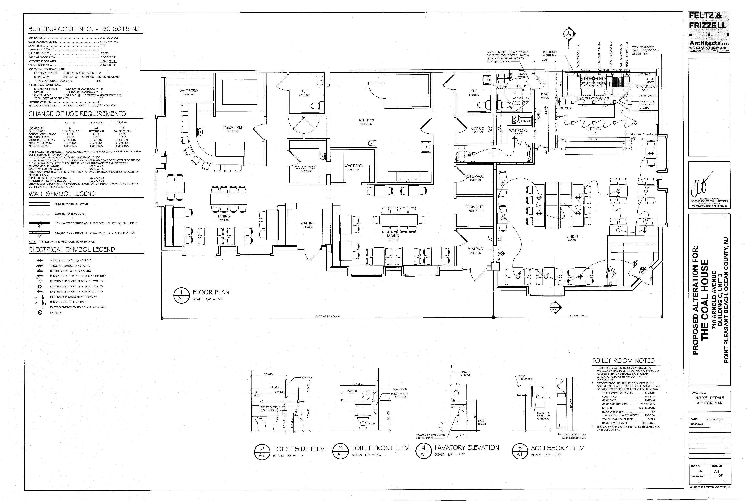
Construction Documents
Notes:
Construction Documents – these are the plans the contractor will use to build the project, and which will be used to get a building permit.

Slide 16
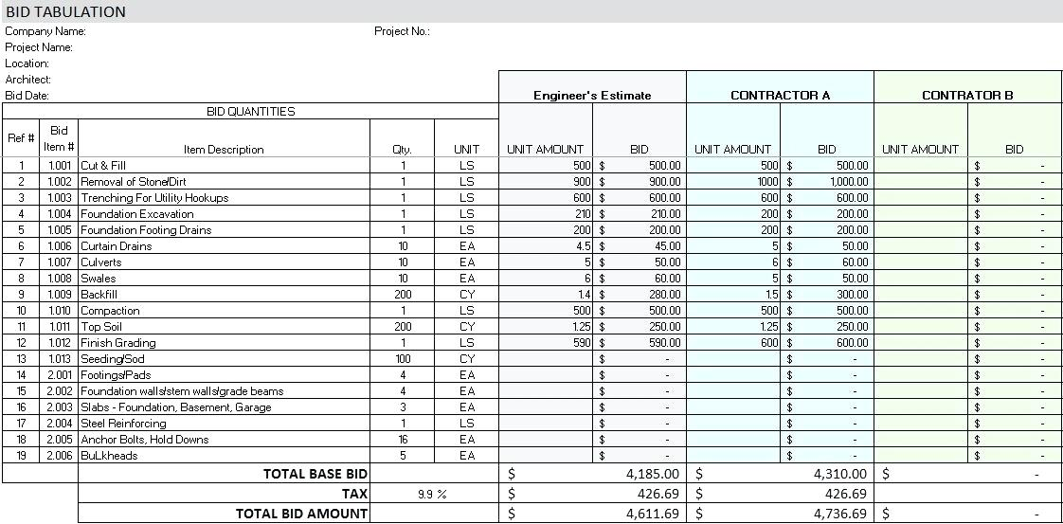
Bidding
Notes:
Bidding – Several contractors will look at the plans and do cost estimating. They may have questions, which will be addressed by the architect.

Slide 17

Construction Administration
Notes:
Construction Administration – once the contract is awarded, and the project begins, the architect will be on hand to make sure the plans are being followed and to answer any questions the contractor may have.

Slide 18

What kinds of structures does an architect design?
Wherever you live, work, or play,
EVERY BUILDING HAS AN ARCHITECT!
Notes:
What kinds of structures does an Architect Design?
Virtually every building type in every community is designed by an architect.
Be it a house, school, or office, wherever you live, work or play, every building has an architect.

Slide 19
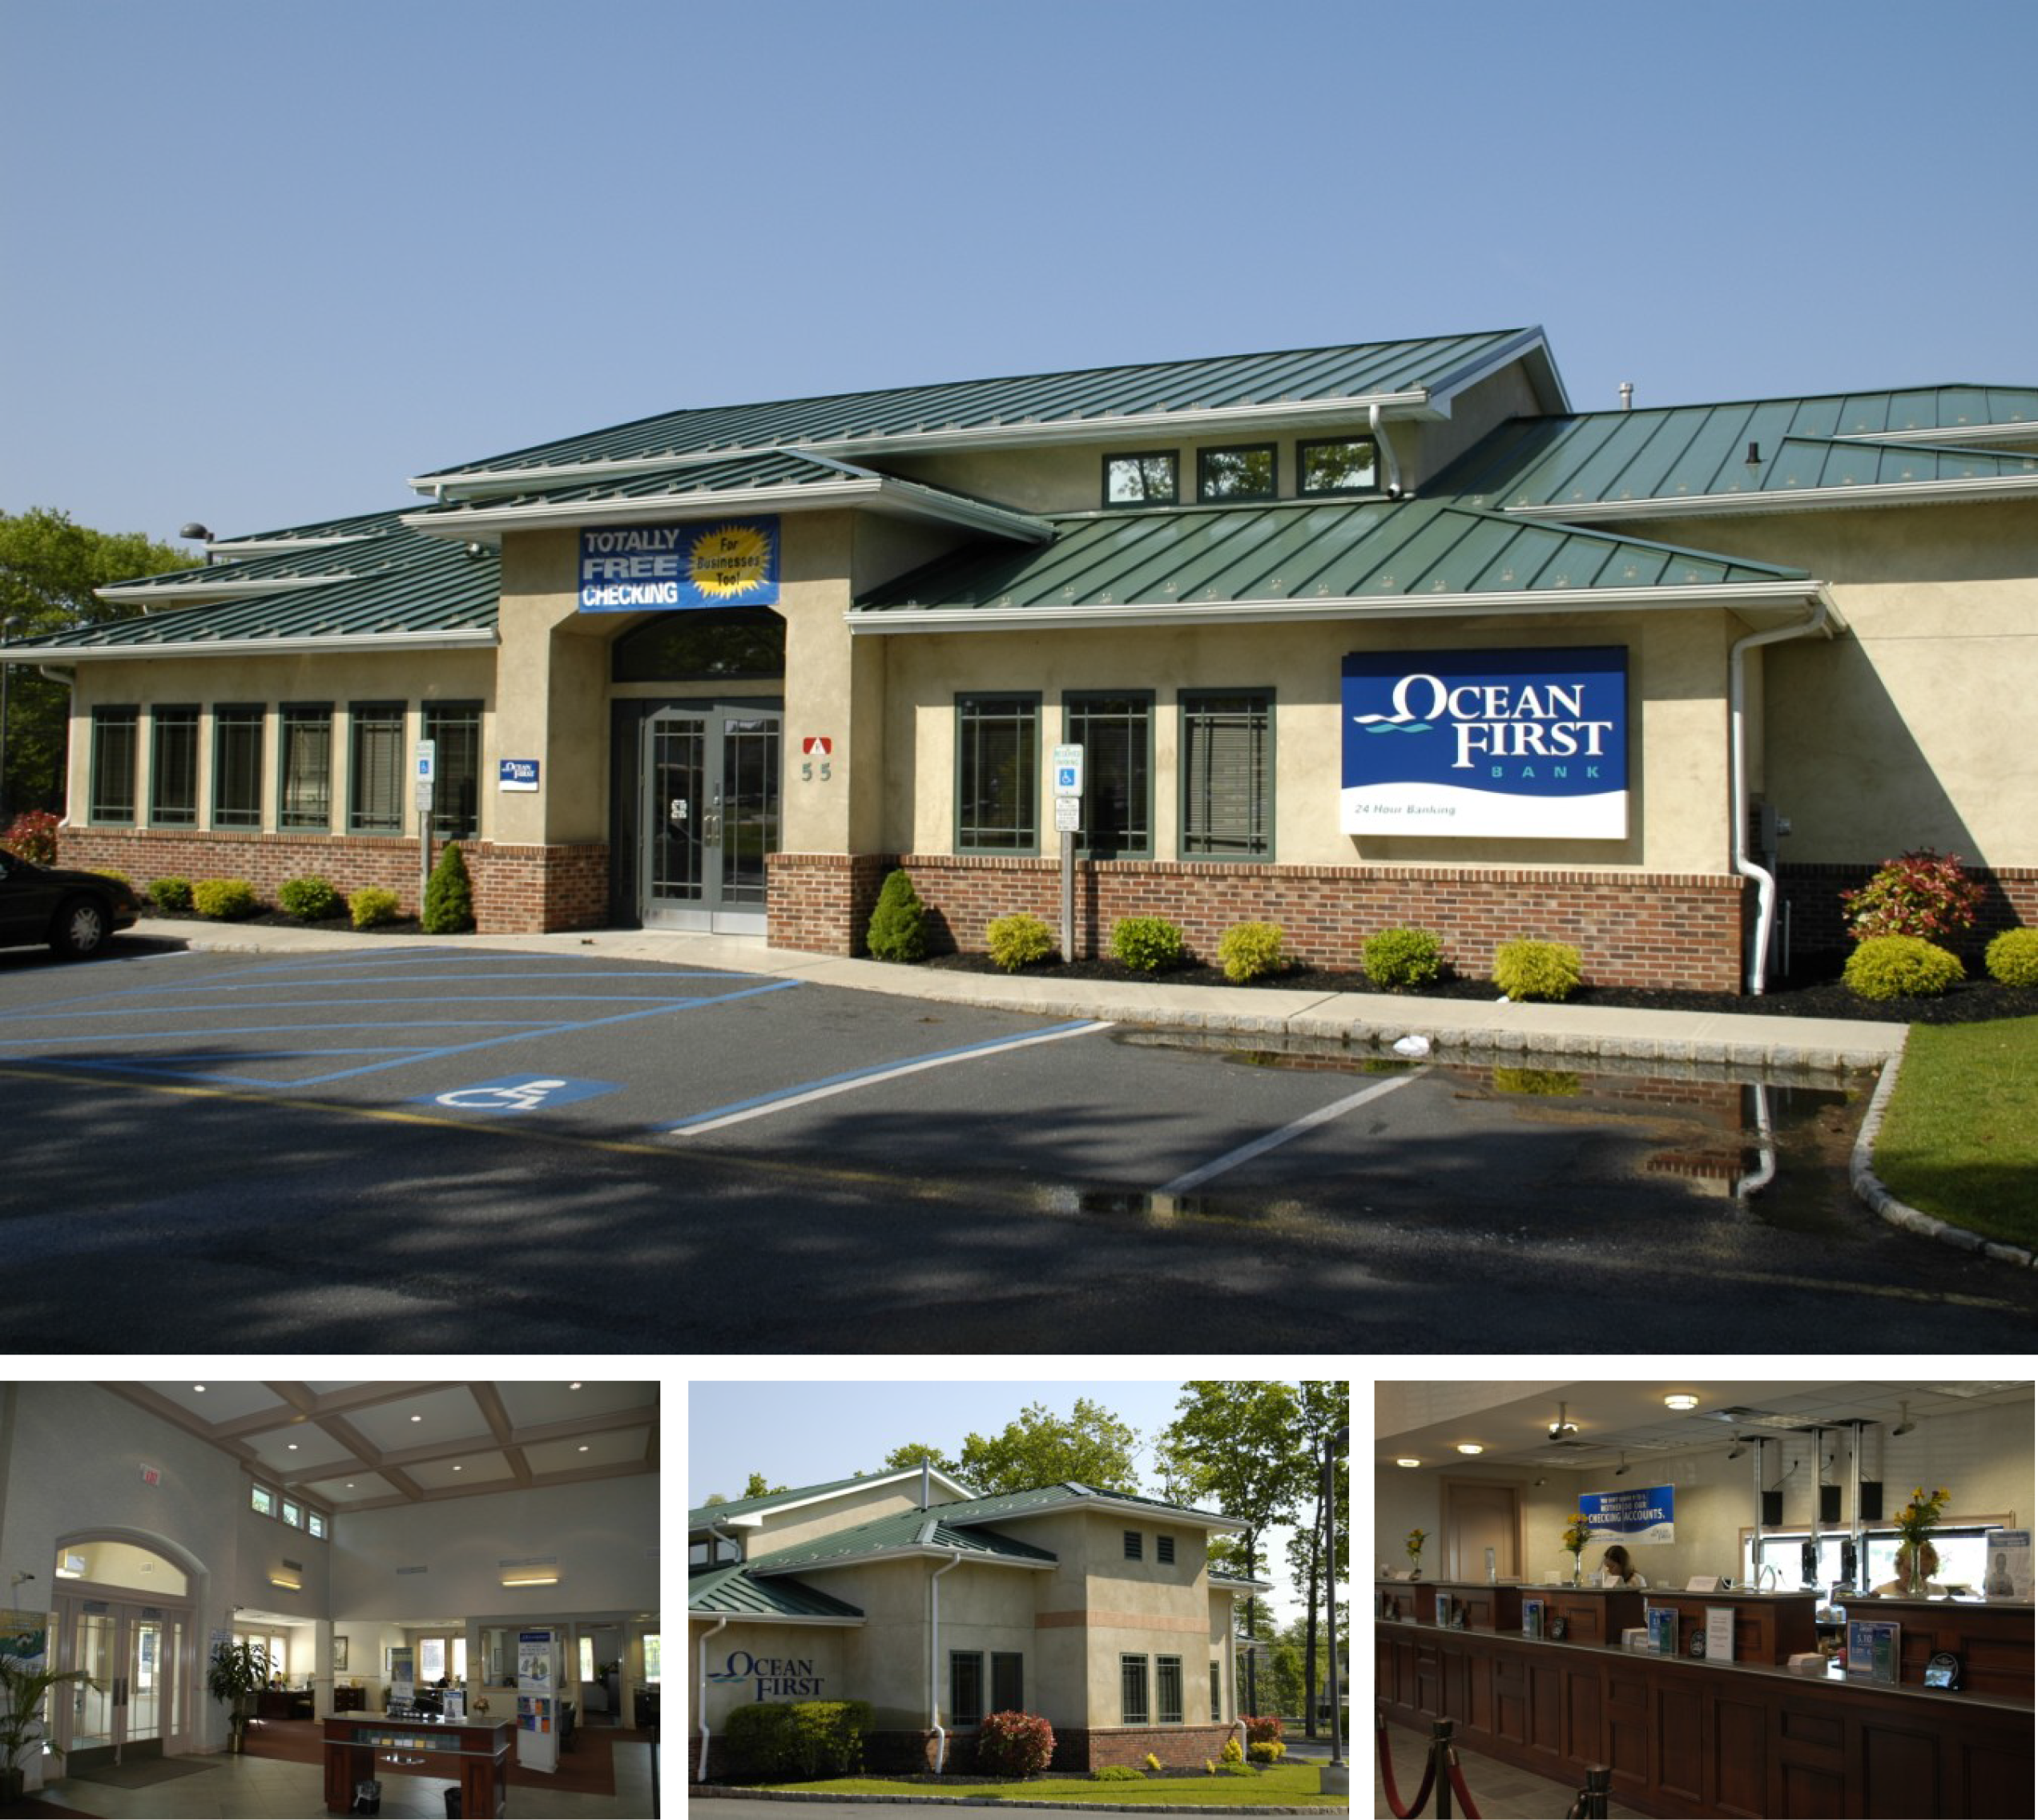
Notes:
Commercial – Places to work and spend money like offices, stores, banks, barbershops and restaurants.
This is the Toms River Branch of OceanFirst Bank, which I designed.

Slide 20
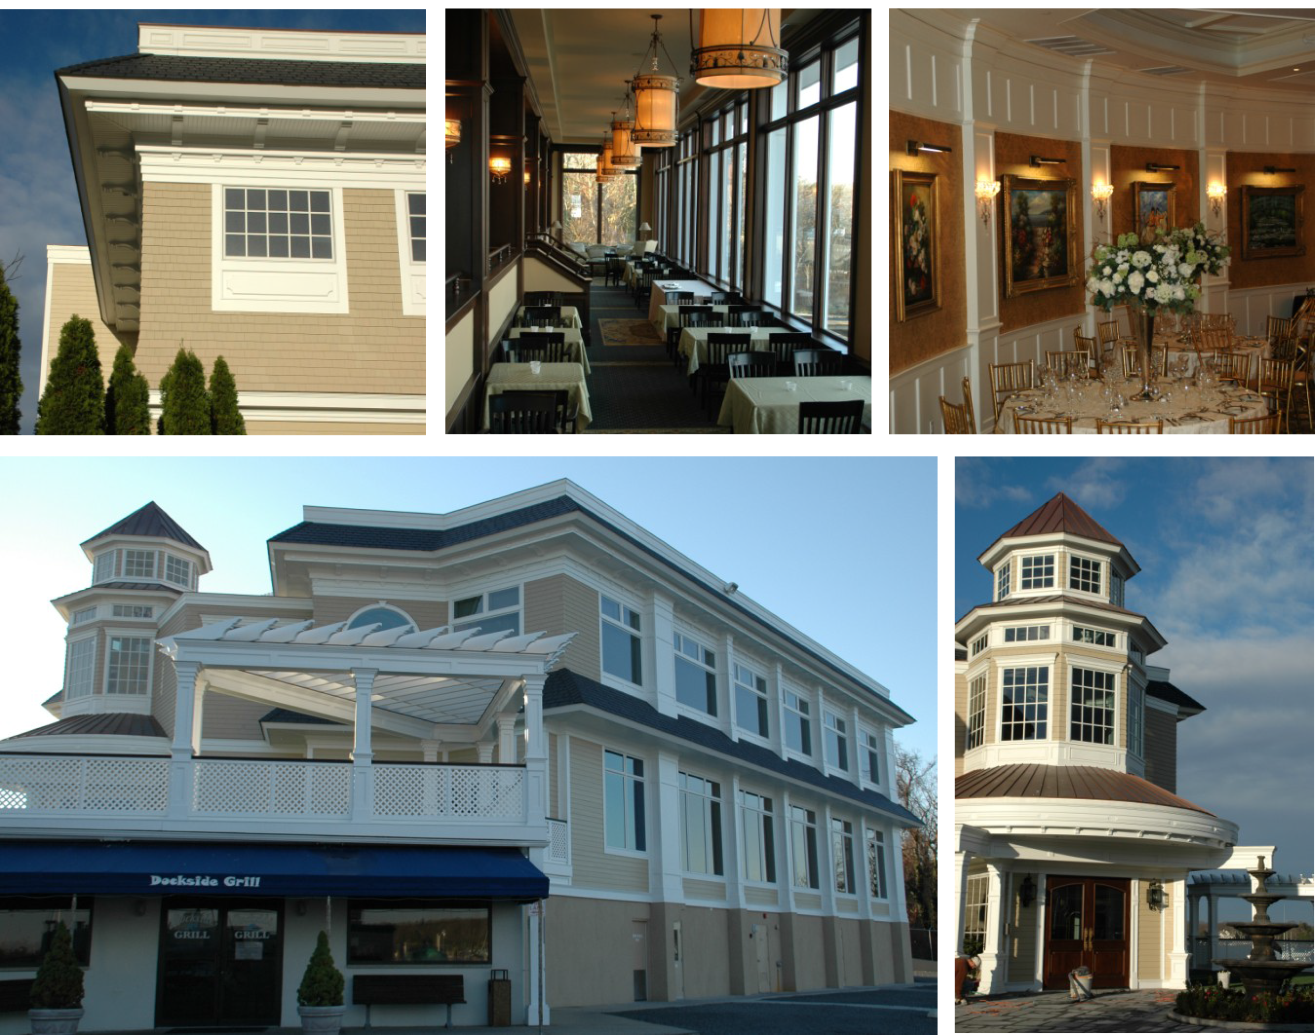
Notes:
Banquet halls like Clark’s Landing, which our firm designed.

Slide 21
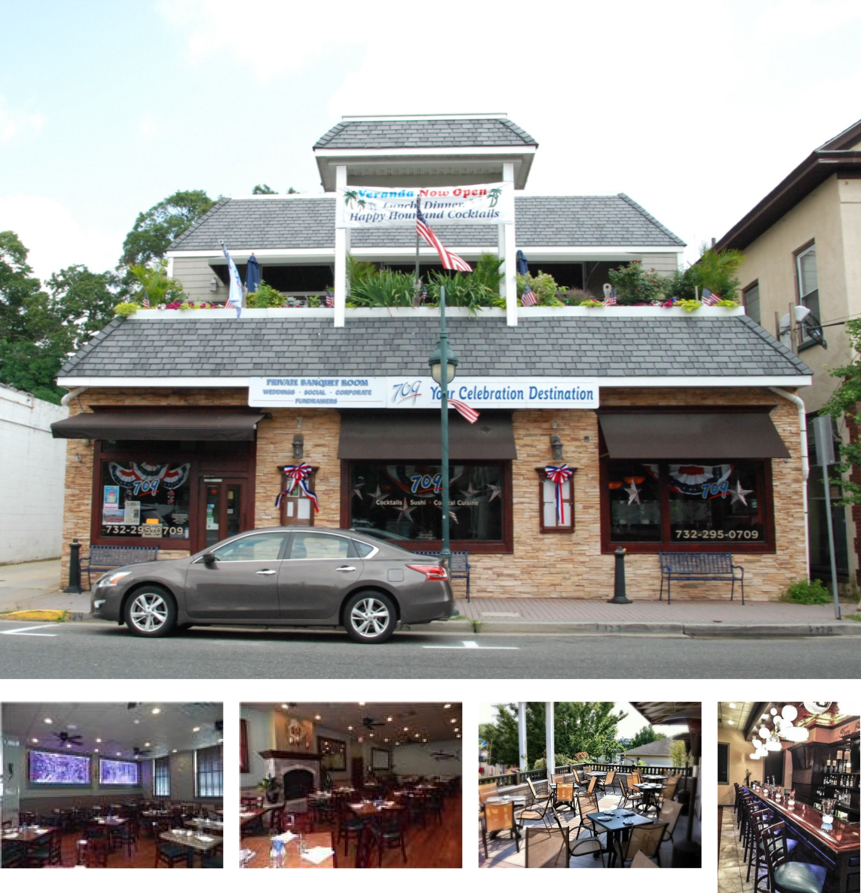
Notes:
Restaurants like 709, which is now B2 Bistro. I designed the original building and worked with an interior designer for the renovation.

Slide 22
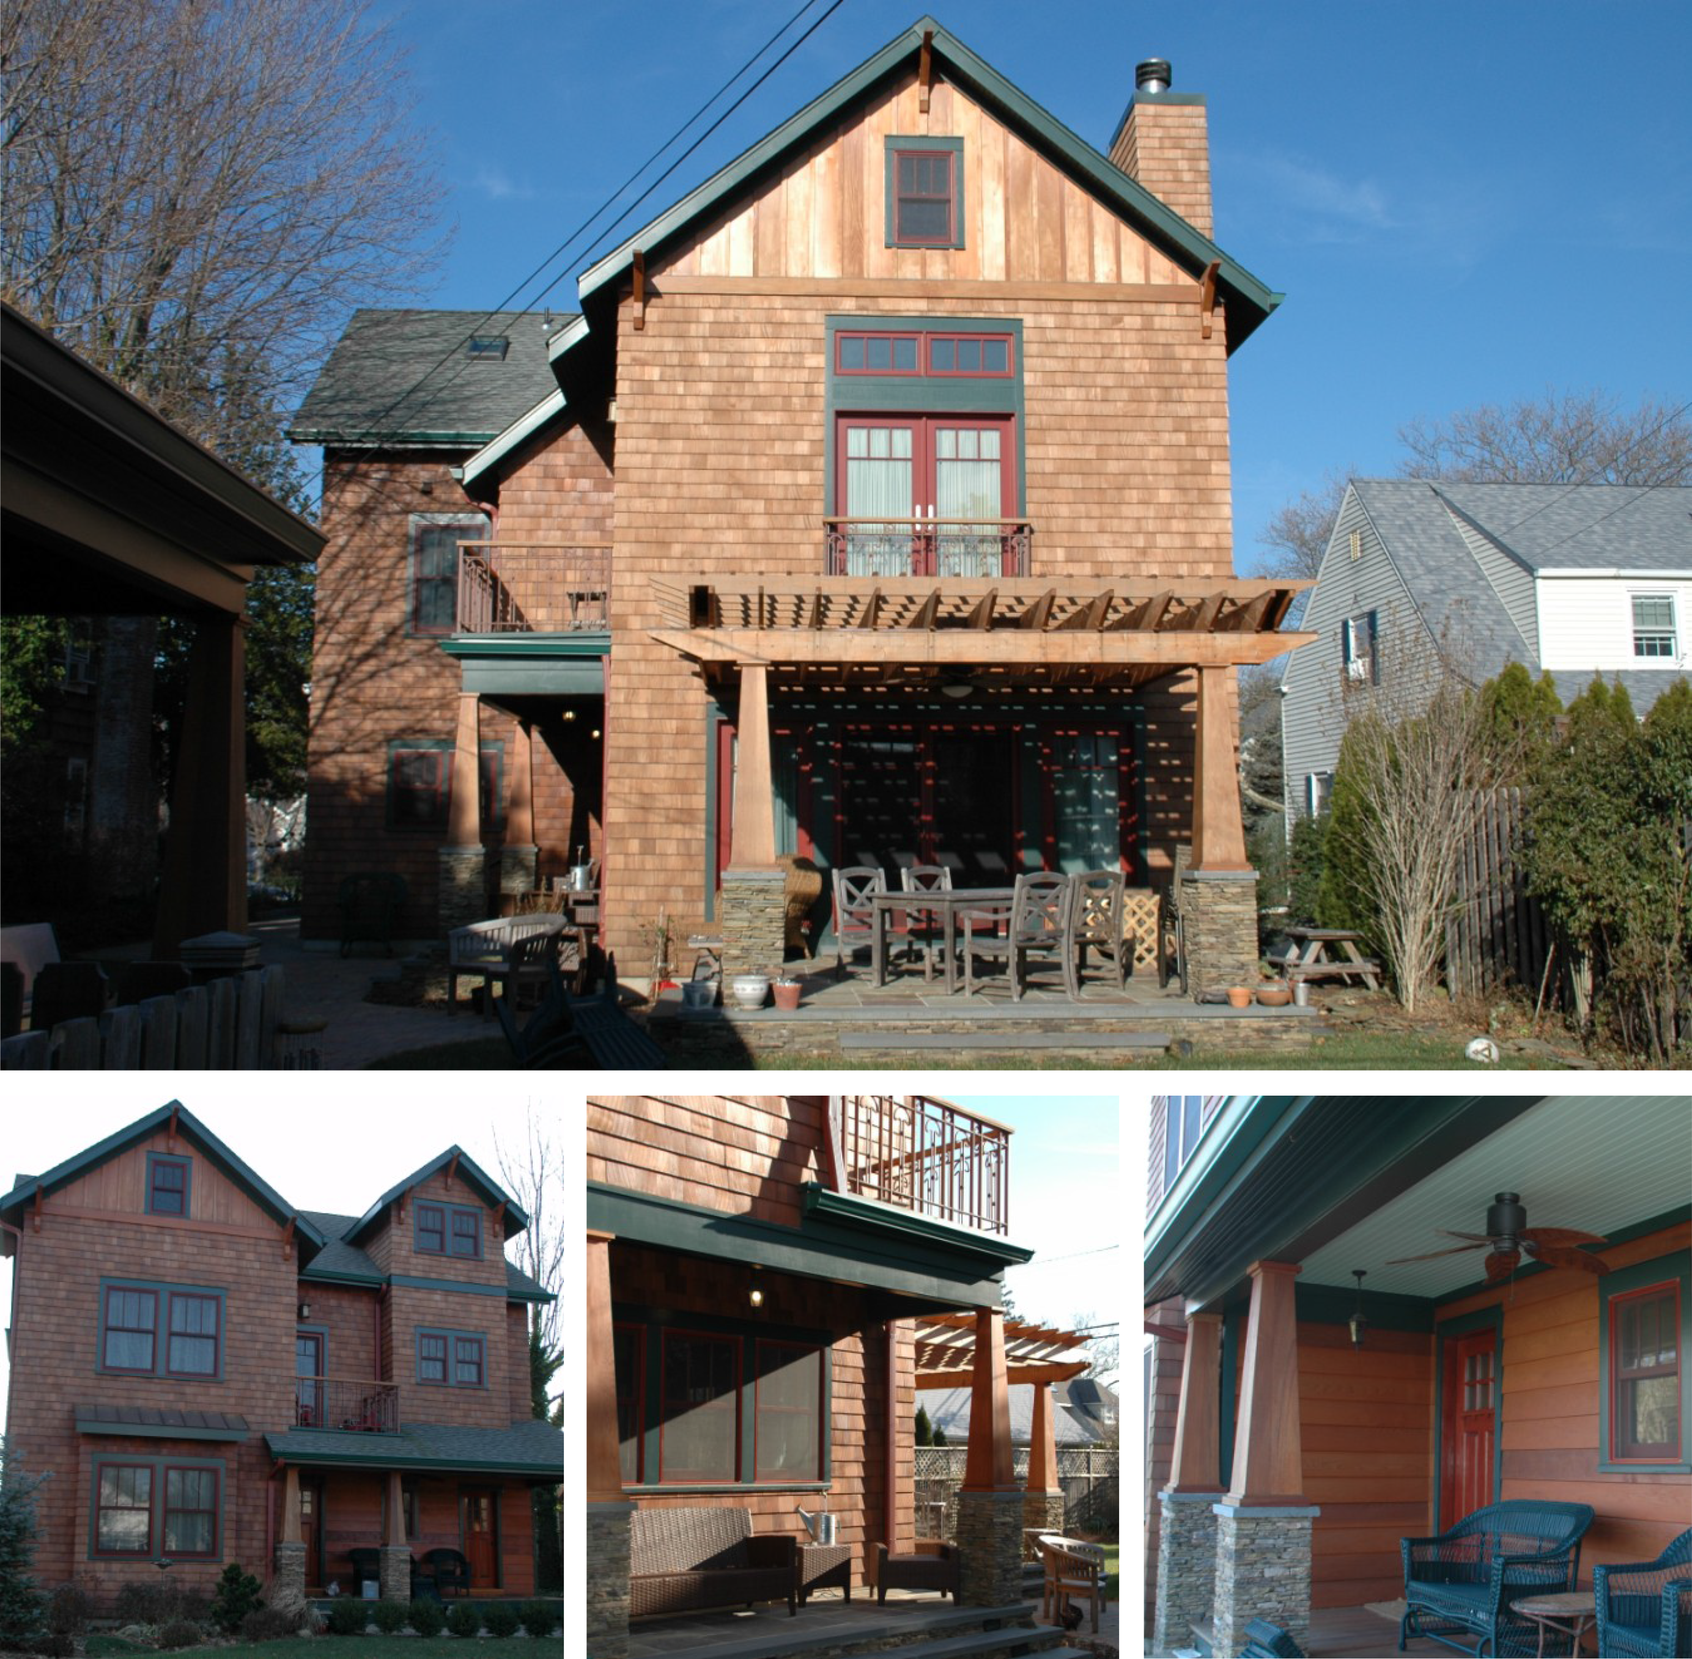
Notes:
Residential – Places to live like houses and apartment buildings. This is a house I designed in Sea Girt.

Slide 23
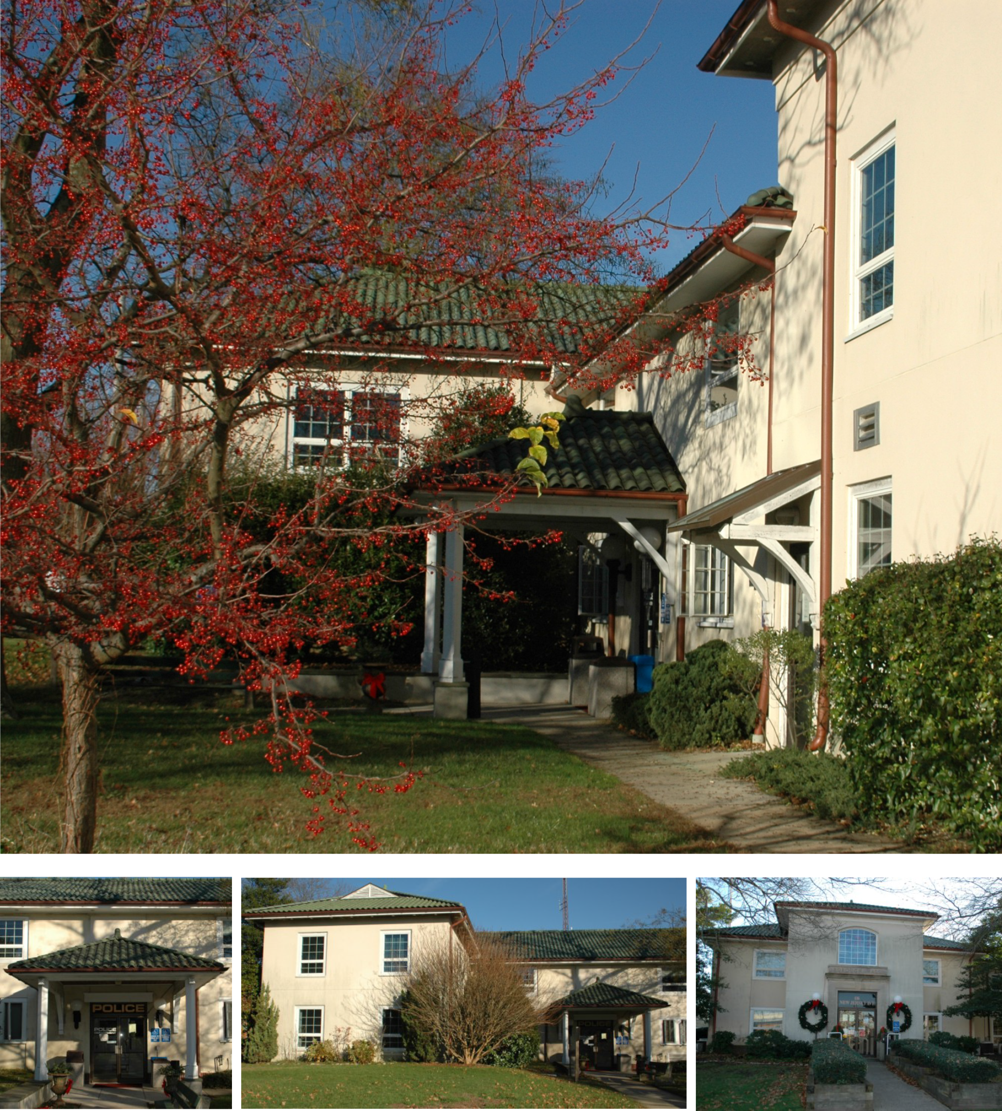
Notes:
Public Buildings – Places provided by the municipality like the town hall, post offices, library, recycling center, schools, community center, and
town pool.
This is the Point Pleasant Beach Borough Hall. My firm designed an addition to it in the late 90’s.

Slide 24

Notes:
Institutional Buildings – like hospitals and universities
I didn’t design this building, but I have worked on a few hospital spaces.

Slide 25
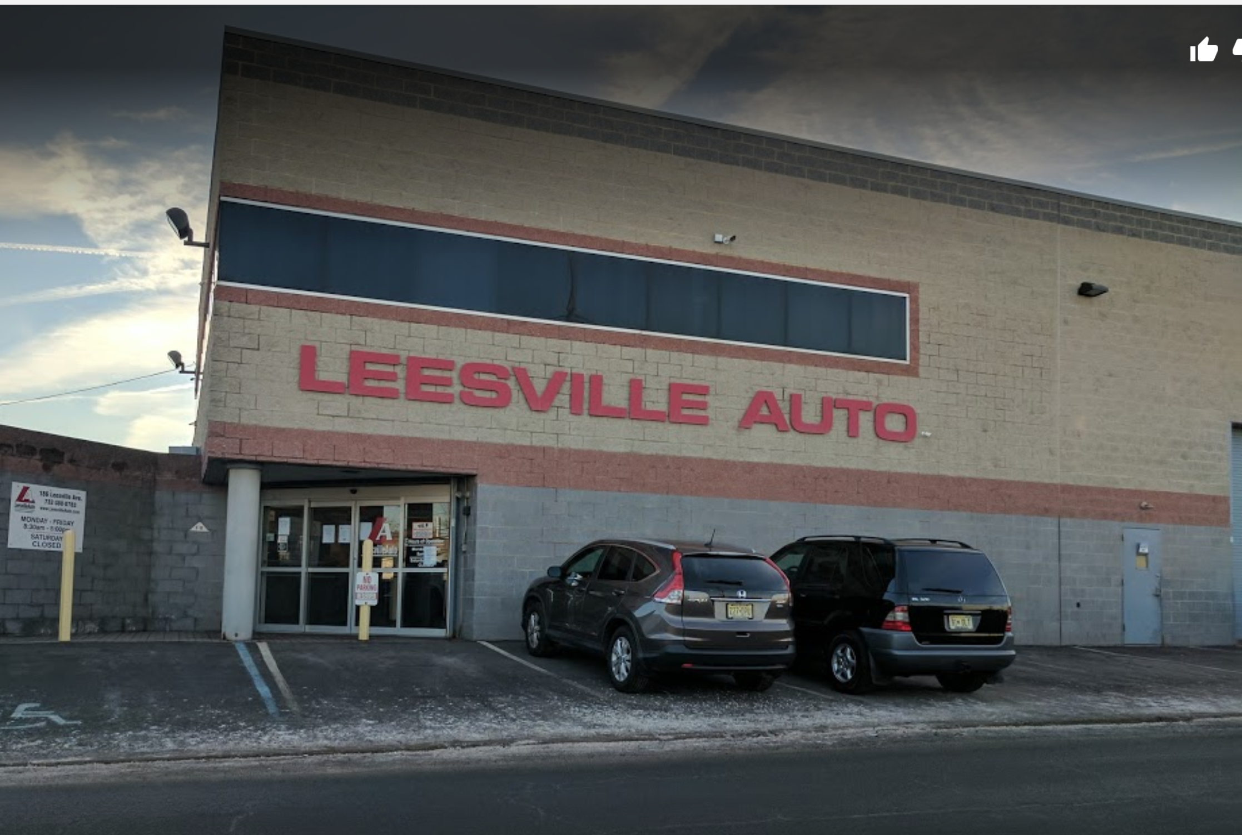
Notes:
Industrial – Places where things are manufactured like wood shops and factories.
This is an auto wrecker in northern NJ that disassembles cars and sells the parts that I designed.

Slide 26
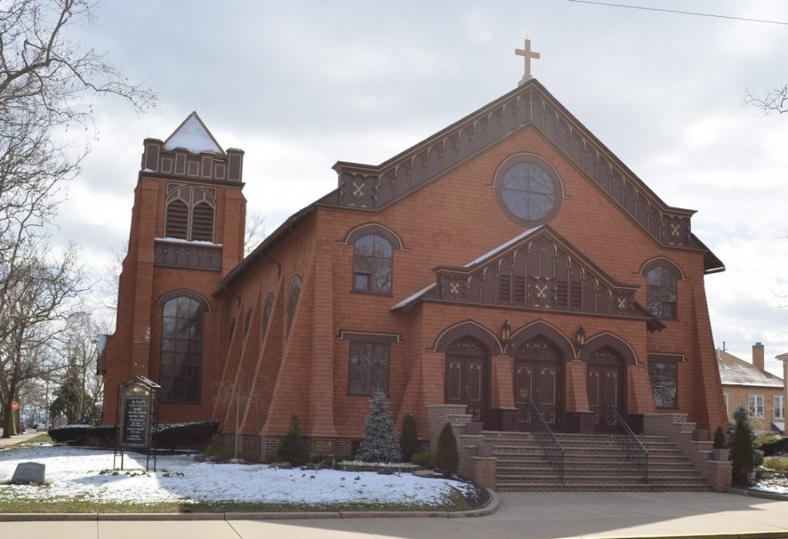
Notes:
Religious – churches, temples, synagogues.
You may recognize St. Peters in Point Beach, which I did not work on.

Slide 27
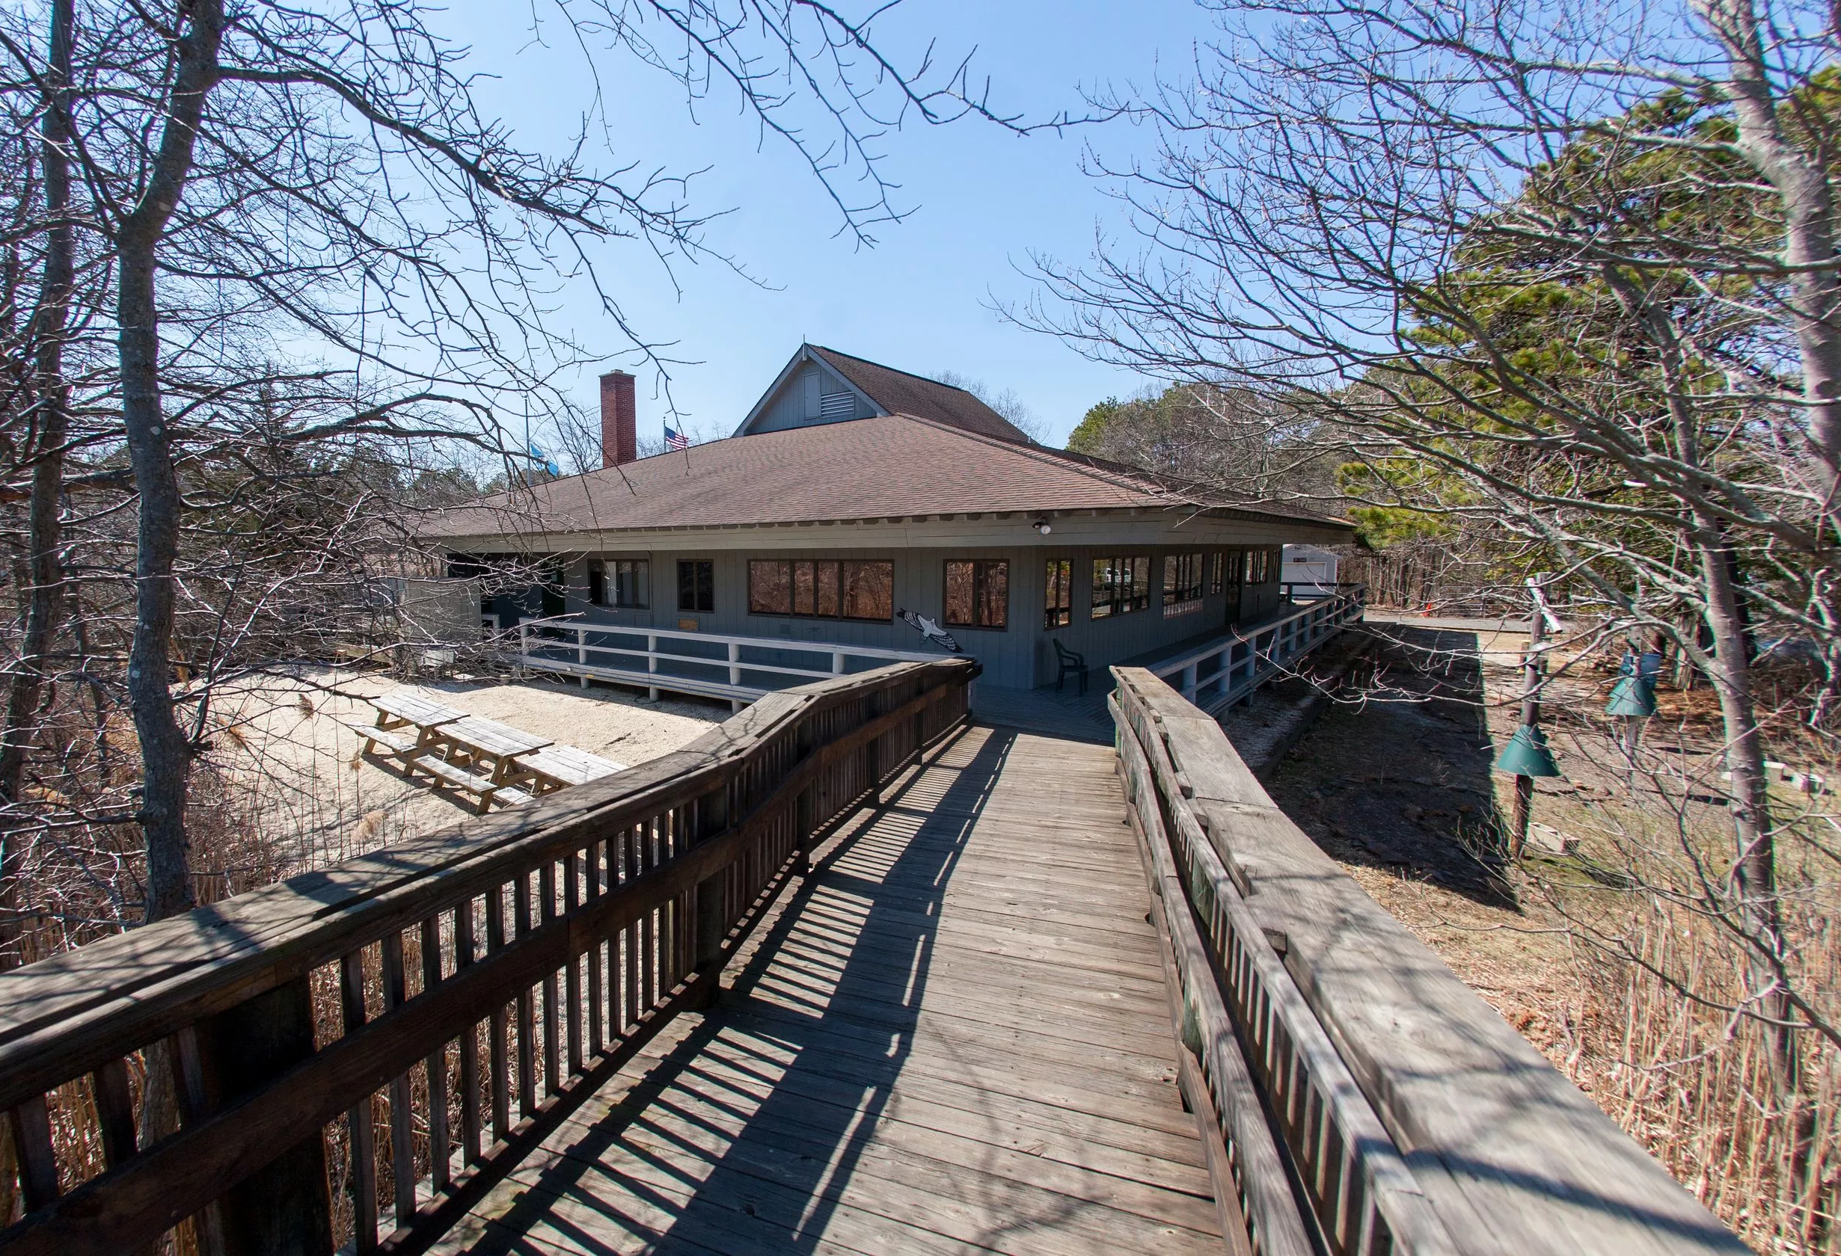
Remember: wherever you live, work or play,
EVERY BUILDING HAS AN ARCHITECT.
Notes:
Recreational – parks, lakes, ball fields, and playgrounds. This is Cattus Island County park, recently reconstructed after Sandy by another local architect.
Remember: Be it a house, school, or office, wherever you live, work or play, every building has an architect.

Slide 28
Questions?
Verity L Frizzell, FAIA
verity@feltzandfrizzellarchitects.com
732-892-0208

