Slide 1

High School
18 January 2018
Fallon+Pacheco Architects
John Fallon, AIA

Slide 2
About today
What I hope to accomplish
To convey the importance of architecture and good design
To provide a glimpse of what it’s like to be an architect
To express what I found in being an architect
To give information on preparing to study architecture
To pass on what architecture school is like
To explain what it takes to be an architect
Fallon+Pacheco Architects

Slide 3
Some Reasons
to become an Architect
You get to see your work built
You can positively affect everyone’s lives
So….. you can make the world a better place
It is a diverse, changing and creative profession
It opens your eyes
Architecture is a respected profession
Fallon+Pacheco Architects

Slide 4
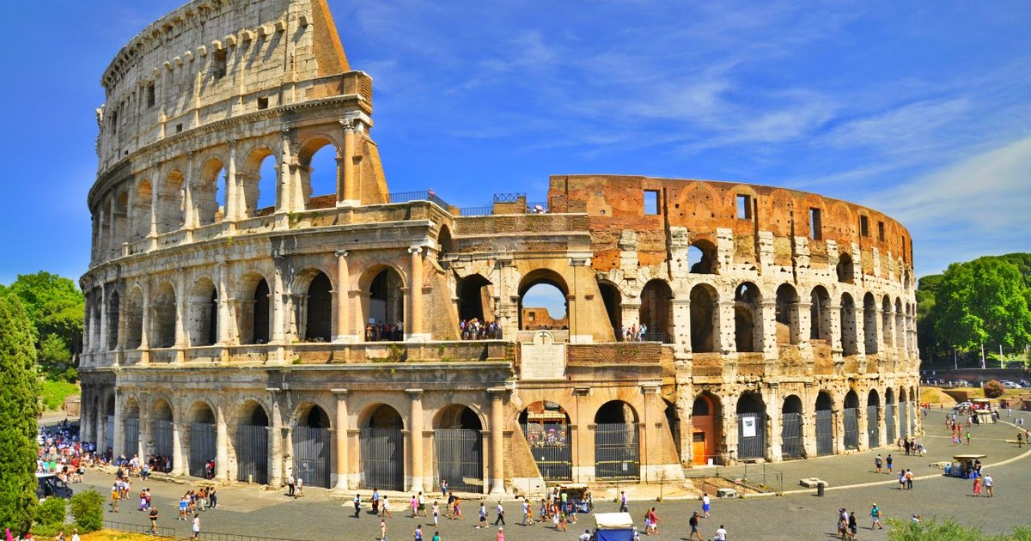
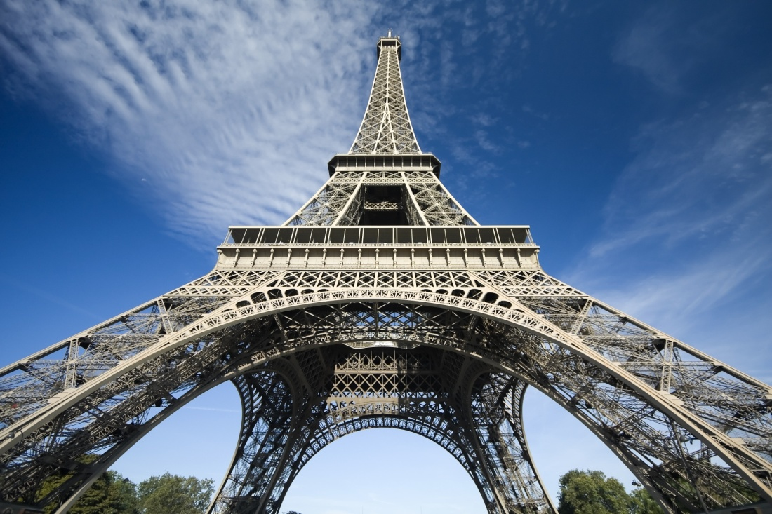
Architecture
can make places special
Coliseum in Rome
Eiffel Tower
Fallon+Pacheco Architects

Slide 5


Architecture
can make places special
The Disney Castle
Neuschwanstein Castle
the inspiration for the Disney Castle
Fallon+Pacheco Architects

Slide 6
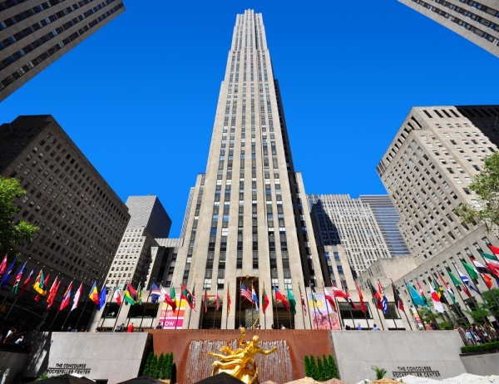
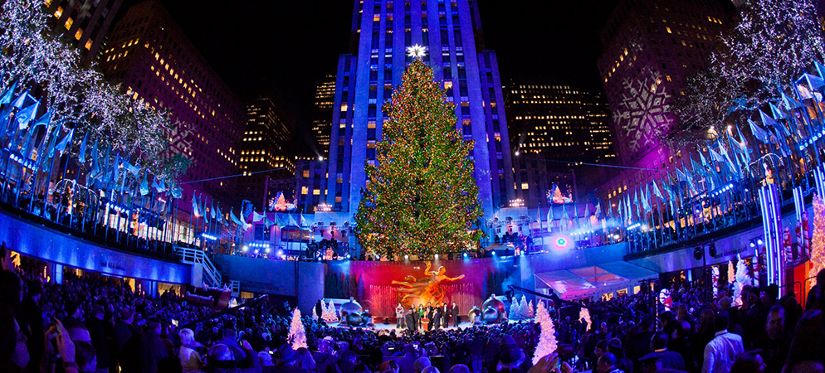
Architecture
can make places special
Rockefeller Center
Architect: Raymond Hood
The Center at Christmas time
Fallon+Pacheco Architects

Slide 7
What you Need
to study Architecture
First, every college and university is different
Math
Art, design and drawing
Physics
Science
History
Fallon+Pacheco Architects

Slide 8
How
do you become an Architect
College Degree in Architecture – Bachelor or Masters
Gain experience as an Intern for 36 months
Take and pass a state licensing exam
Fallon+Pacheco Architects

Slide 9
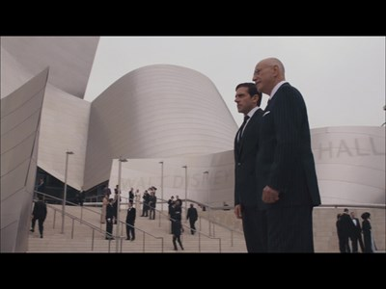
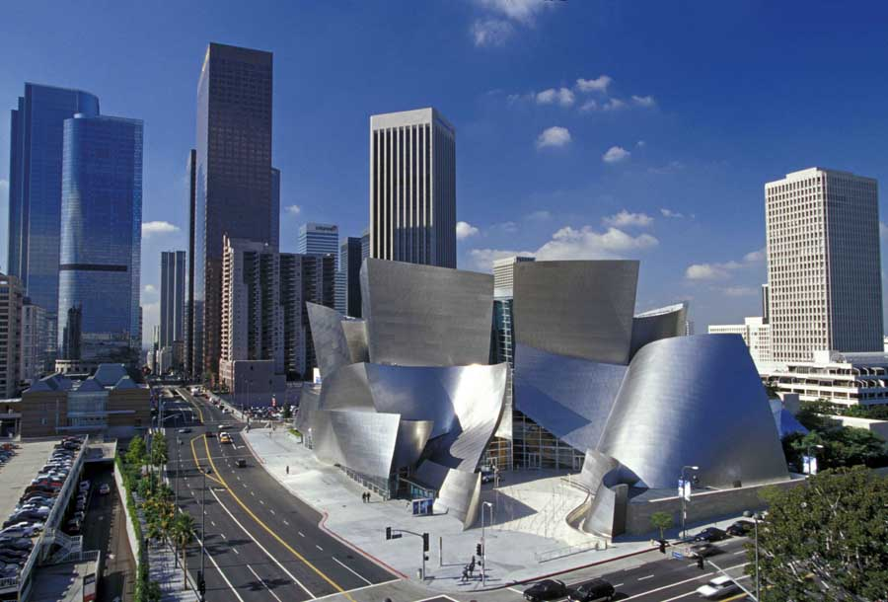
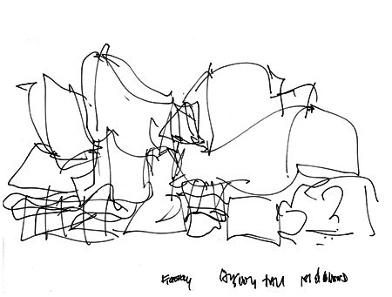
Architecture
can make places special
The movie ‘Get Smart’
Walt Disney Concert Hall
Architect: Frank Gehry
An early conceptual sketch
Fallon+Pacheco Architects

Slide 10
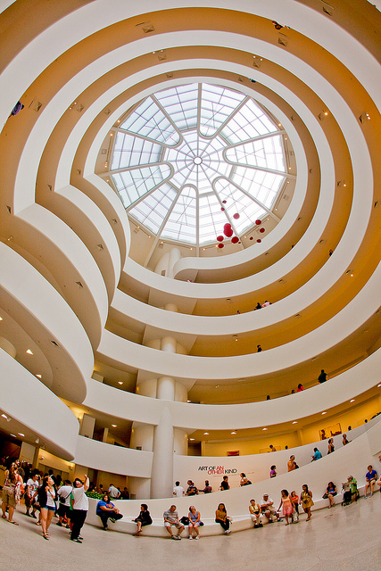
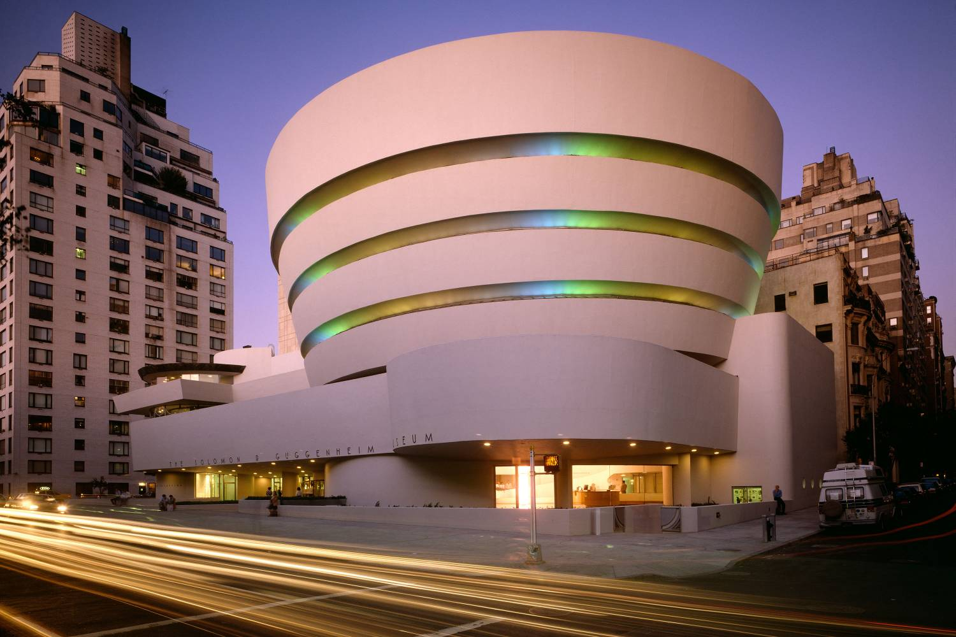
Architecture
Can make places special
The Guggenheim Museum
Architect: Frank Lloyd Wright
Fallon+Pacheco Architects

Slide 11
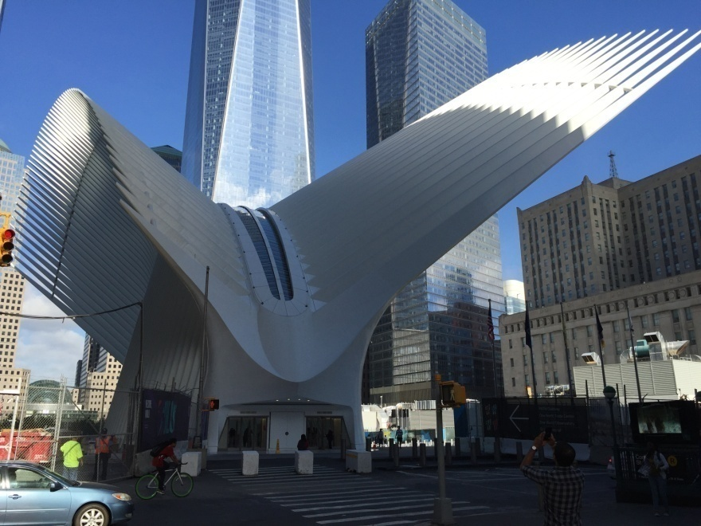
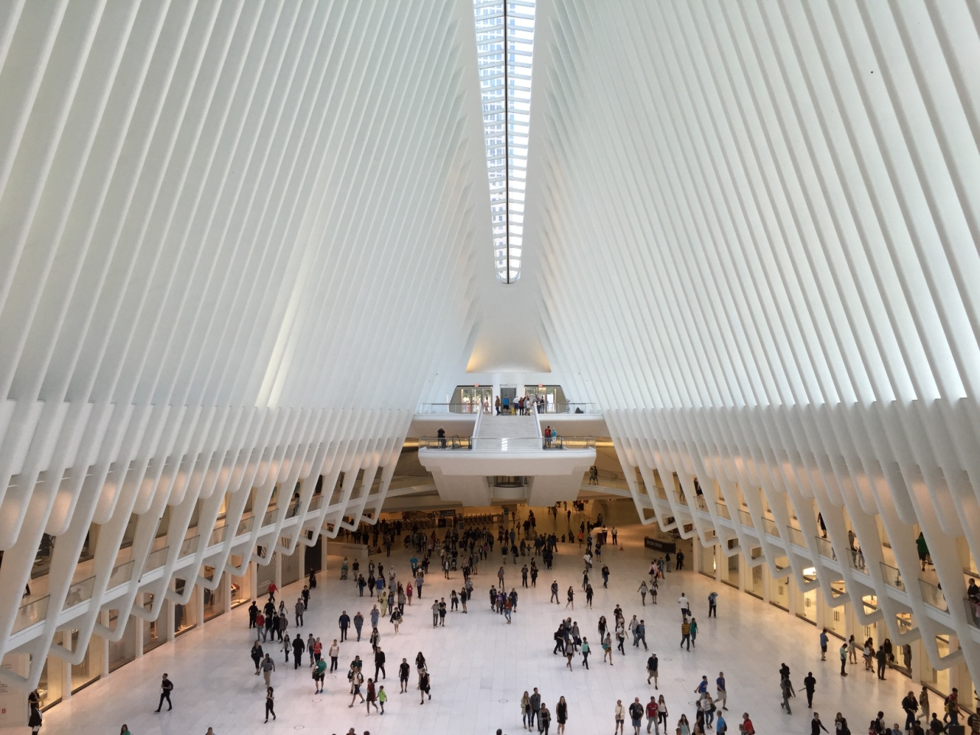
Architecture
can make places special
The Oculus at the World Trade Center
Architect: Santiago Calatrava
Fallon+Pacheco Architects

Slide 12
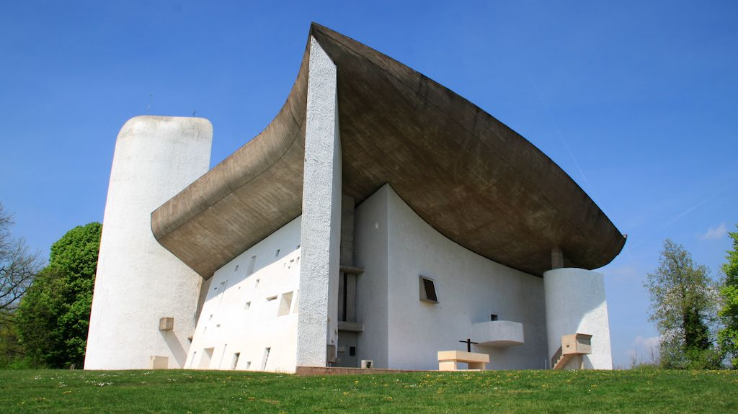
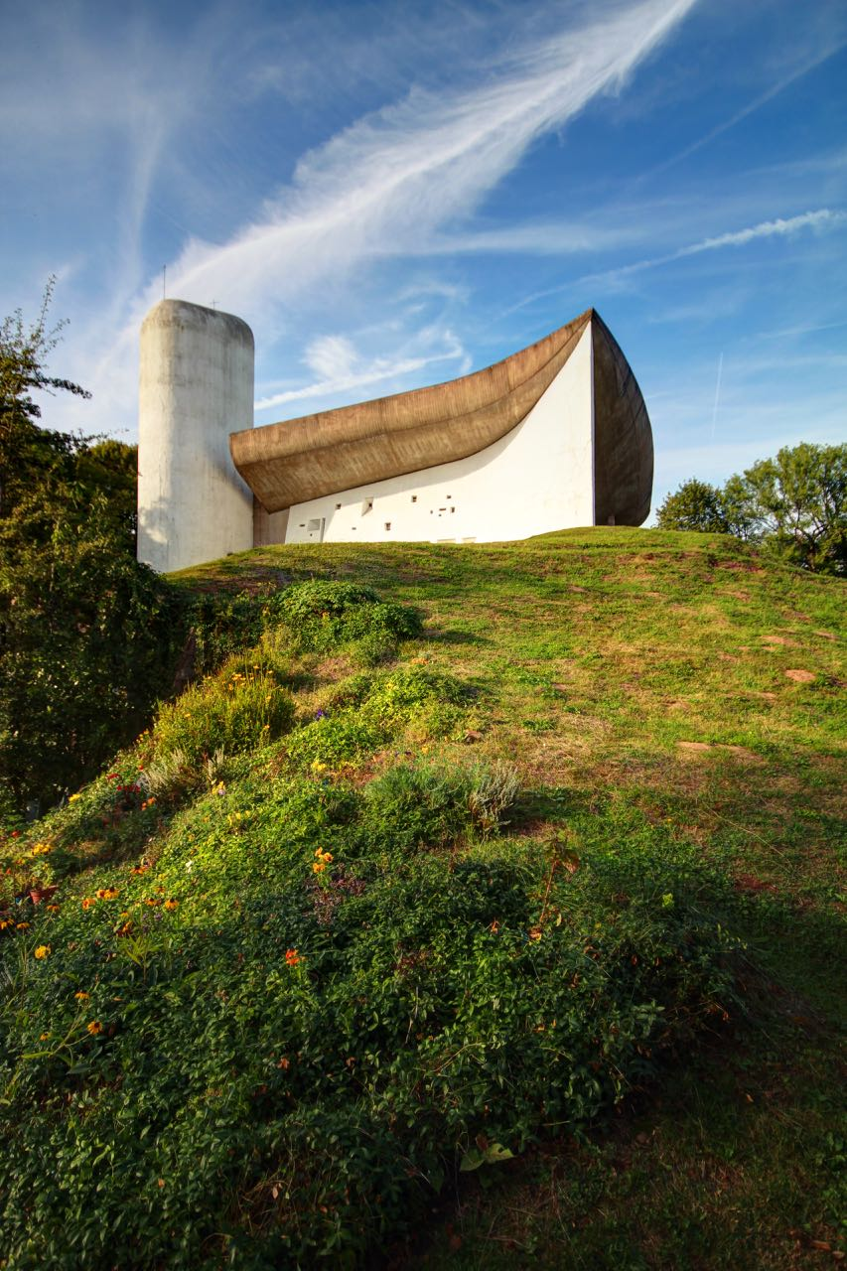
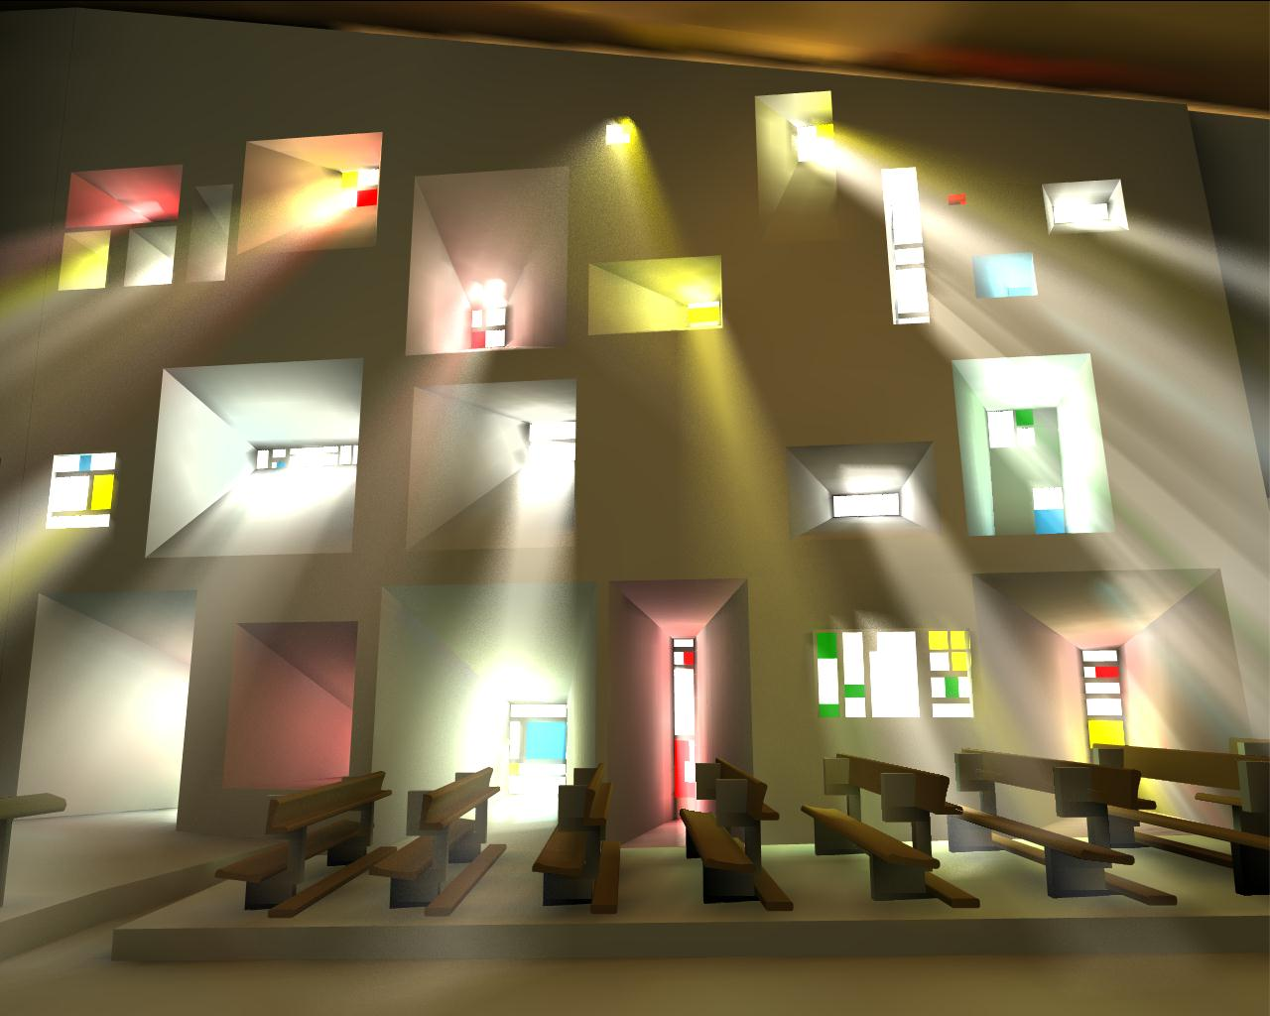
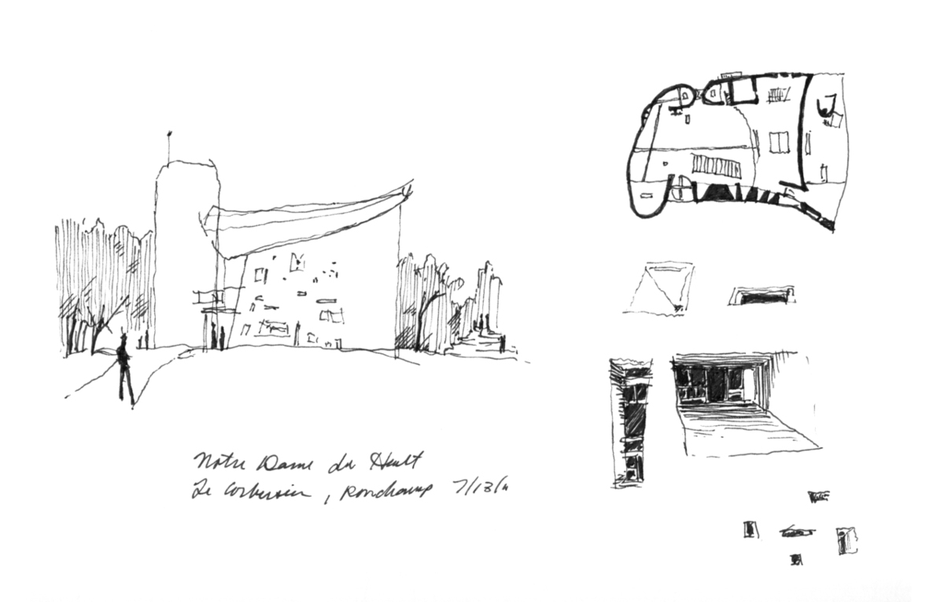
Architecture
Can make places special
The Chapel at Ronchamp
Architect: Le Corbusier
Interior of the Chapel
Early sketch studies
Fallon+Pacheco Architects

Slide 13
It’s a Diverse
profession
A wide range of knowledge base:
Art/Design
History
Health & Safety
Sustainability
Vast variety of products
Structure
Mechanical systems
Electrical systems and lighting
Plumbing systems
Acoustics
Cost Estimating
Marketing
Business/Administration
Communications
Building types
Firm types and sizes
Career Options
Fallon+Pacheco Architects

Slide 14
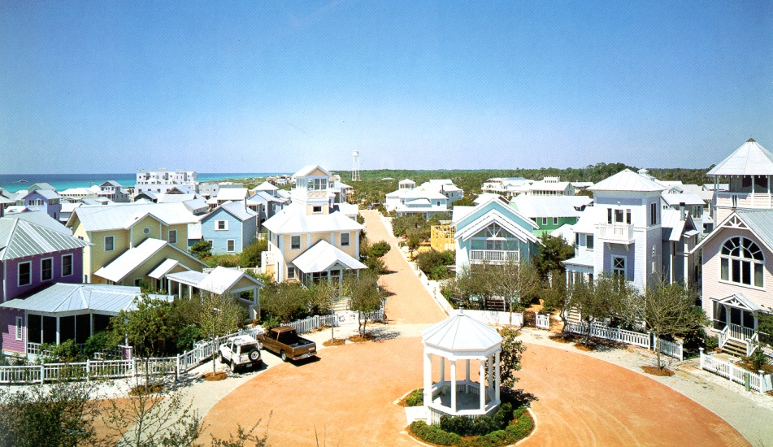

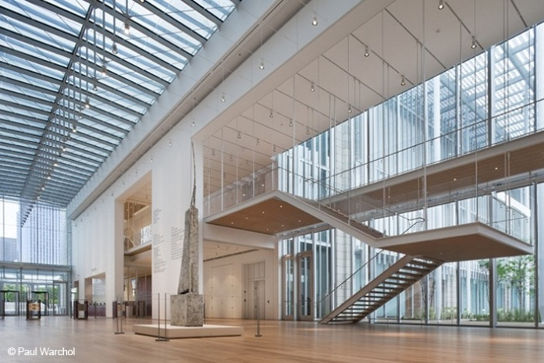
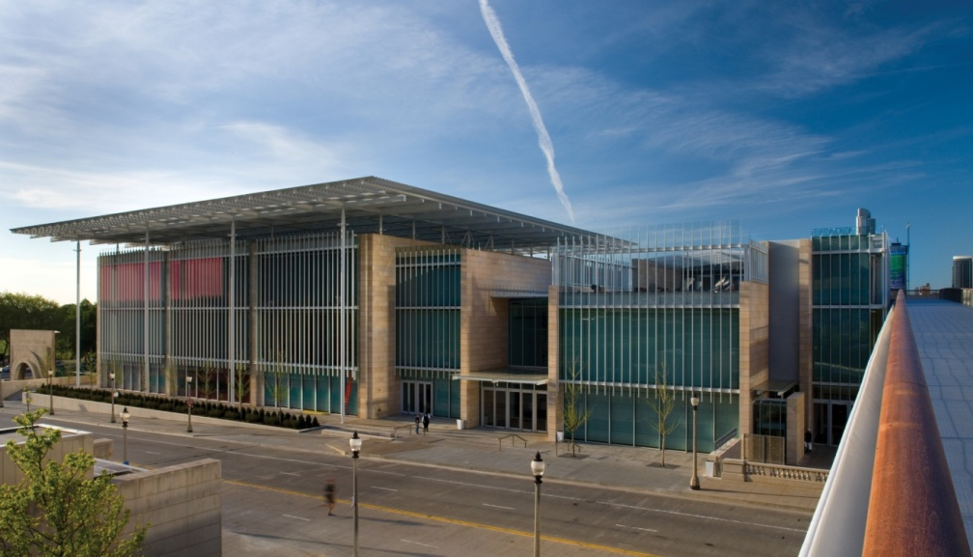
What
Is a project?
Seaside Florida
‘A New Urbanism’
Andres Duany &
Elizabeth Plater-Zyberk
Michael Graves Teapot
Renzo Piano’s
Chicago Art Institute
Fallon+Pacheco Architects

Slide 15


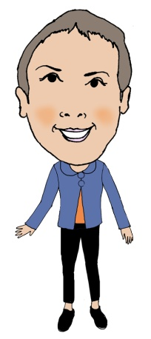
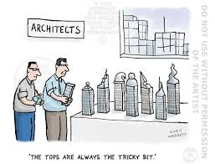

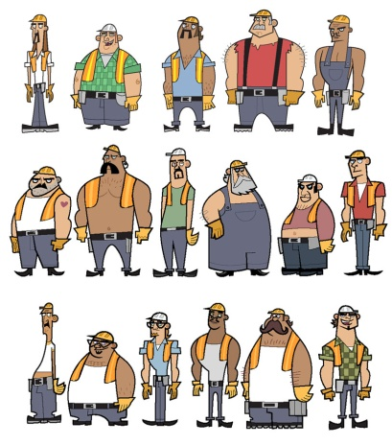
Who
Comprises a project team?
Owner/Client
Architect
Structural Engineer
Mechanical Electrical Plumbing Engineer
Civil Engineer
Landscape Architect
Cost Estimator
General Contractor
or Construction Manager
Fallon+Pacheco Architects

Slide 16
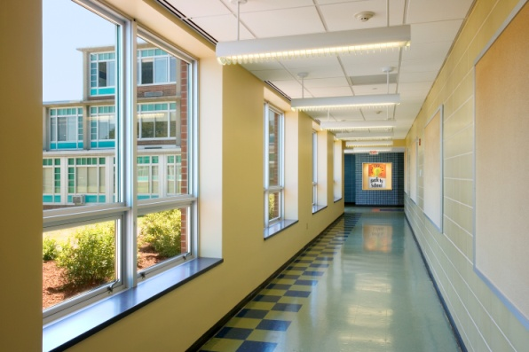
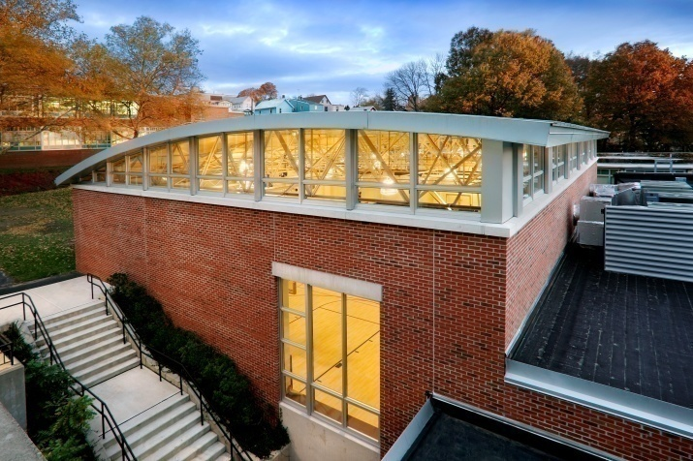
Some of our work
Kearny Franklin School
Multi-Purpose Room Addition
Fallon+Pacheco Architects

Slide 17
Some of our work
Kearny Franklin School
Multi-Purpose Room Addition
Fallon+Pacheco Architects

Slide 18
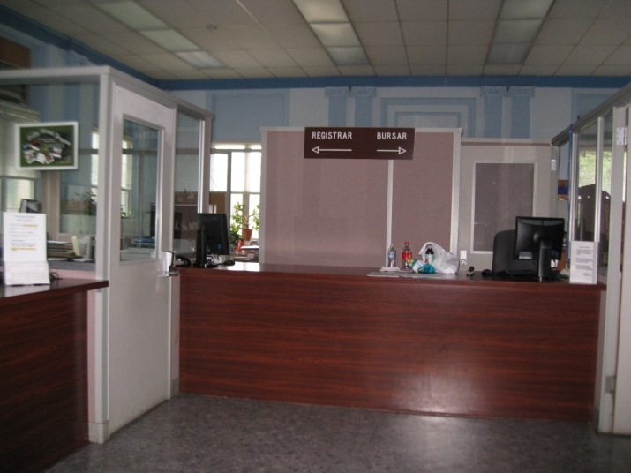
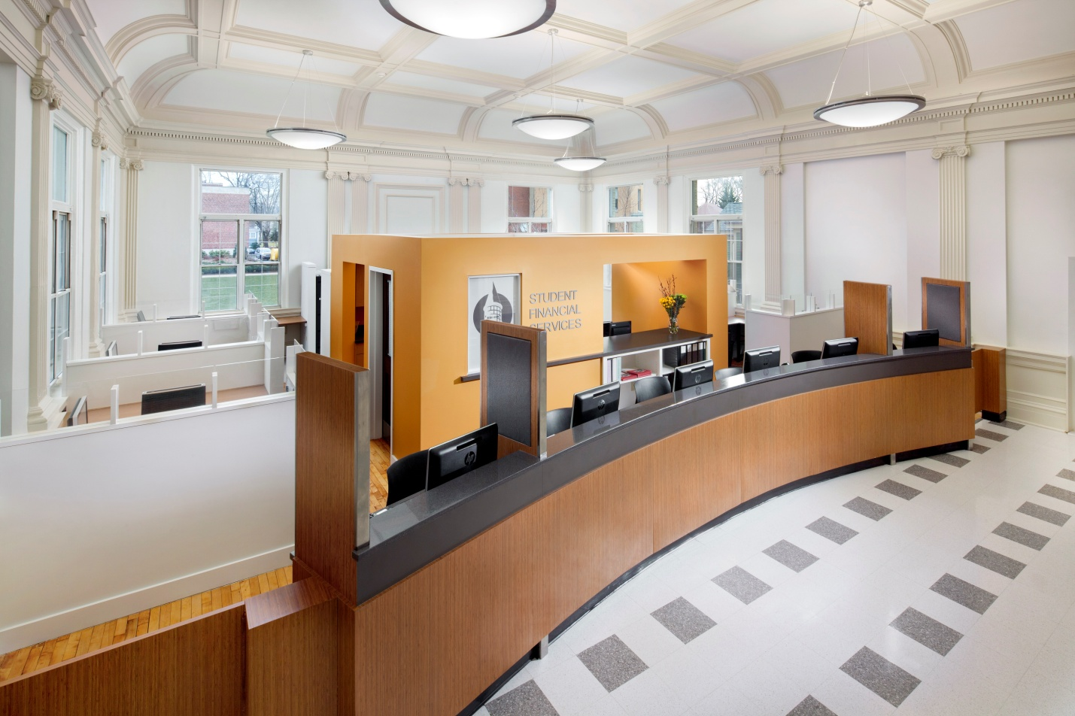
Some of our work
Bloomfield College
Student Financial Services
Before
Fallon+Pacheco Architects

Slide 19
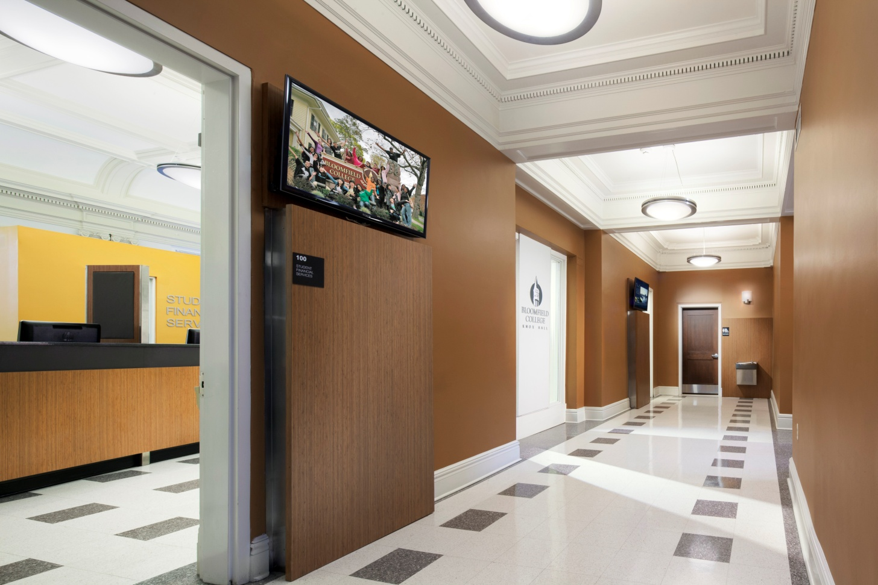
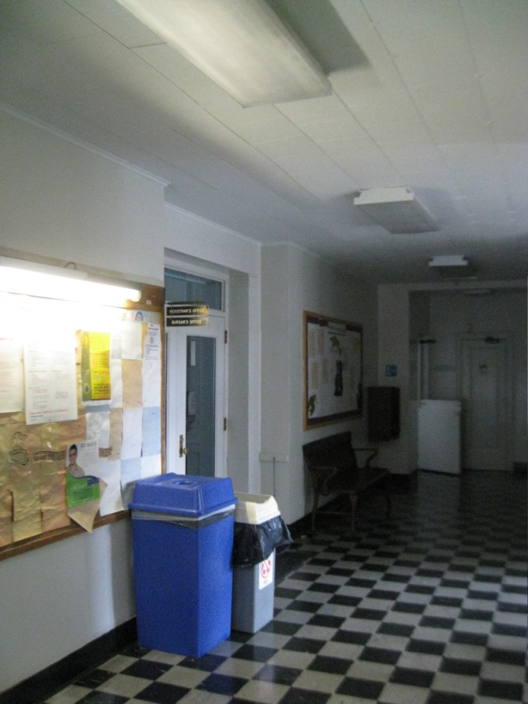
Some of our work
Bloomfield College
Student Financial Services
Before
Fallon+Pacheco Architects

Slide 20
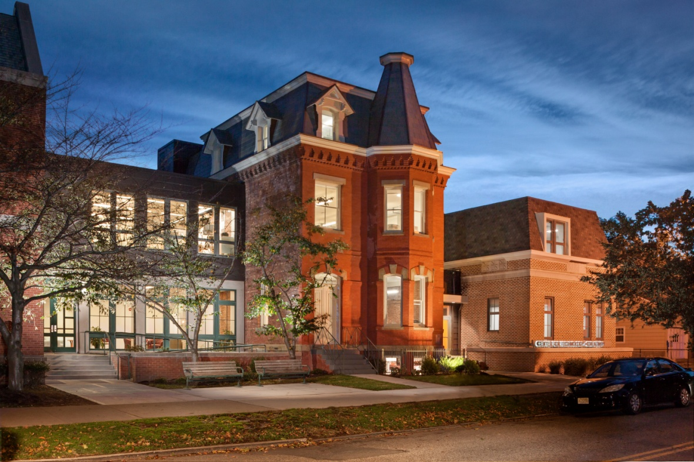
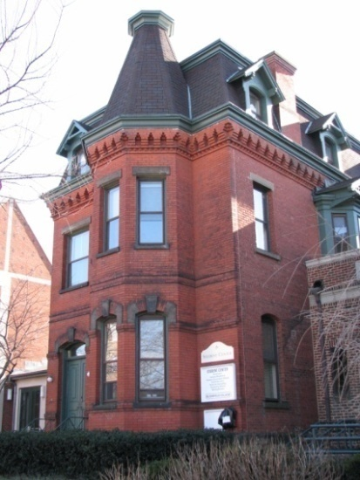
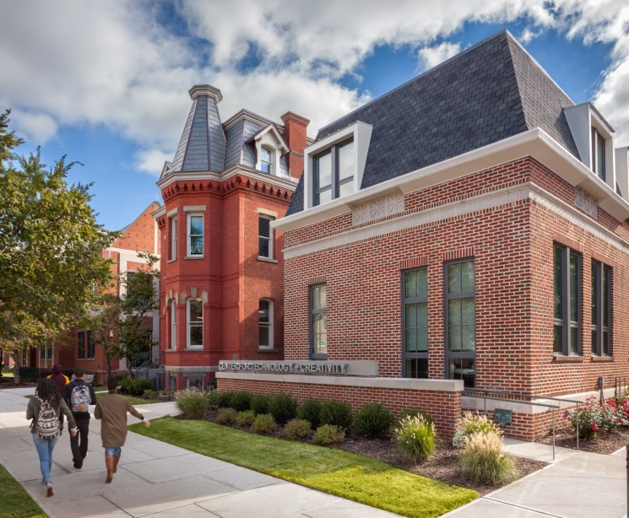
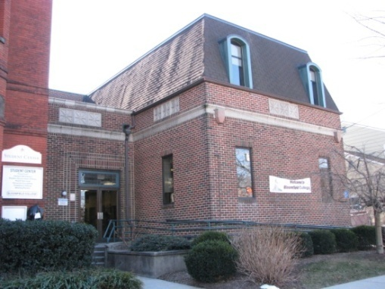
Some of our work
Before
Bloomfield College
Center for Technology+Creativity
Liberty Street Elevation
Before
Fallon+Pacheco Architects

Slide 21
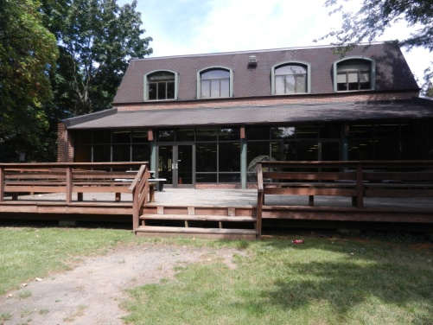
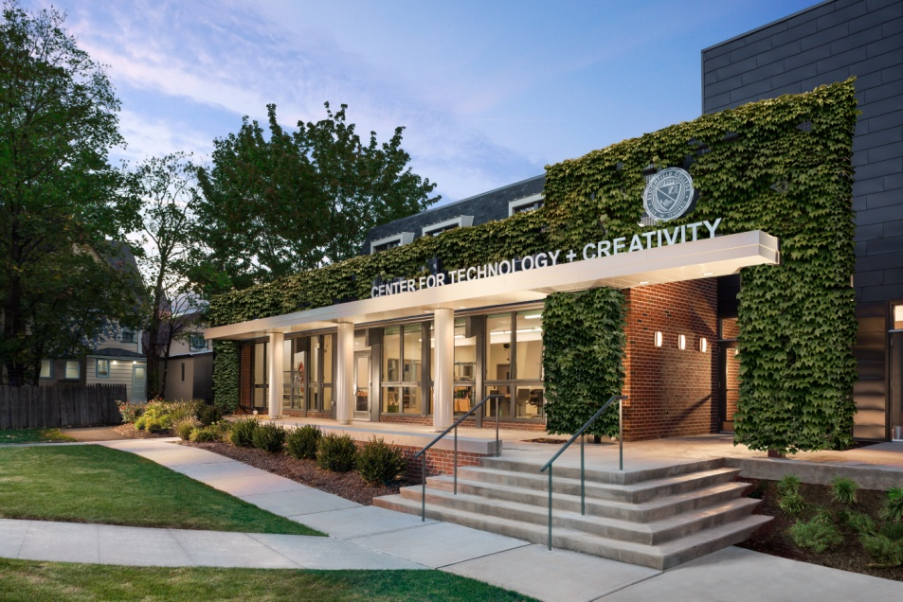
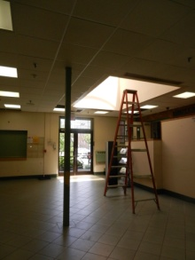
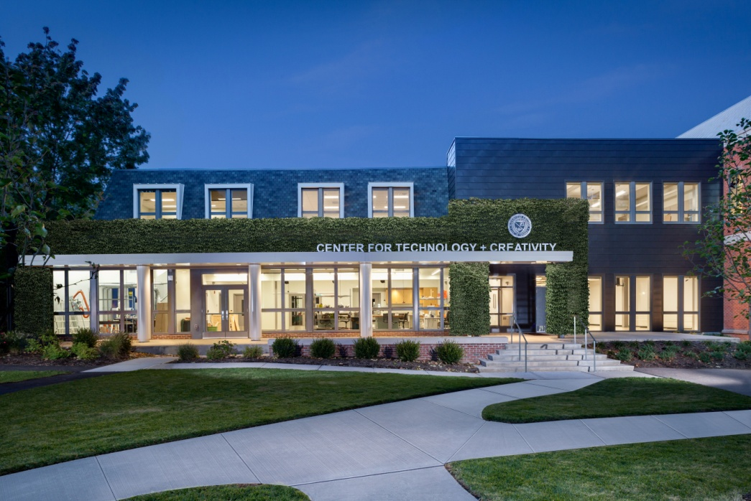
Some of our work
Before
Bloomfield College
Center for Technology+Creativity New Quad Elevation
Fallon+Pacheco Architects

Slide 22
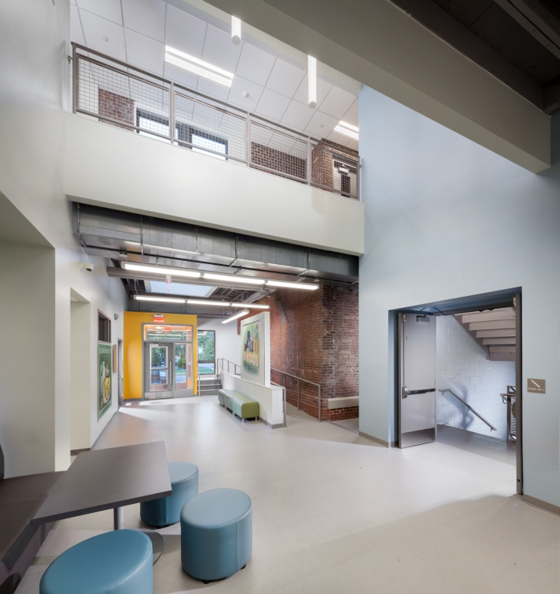

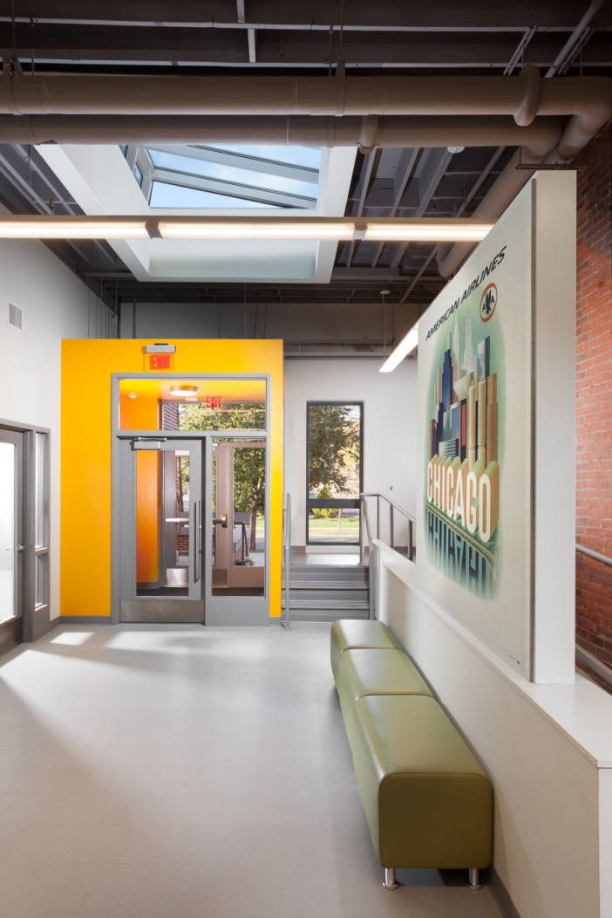
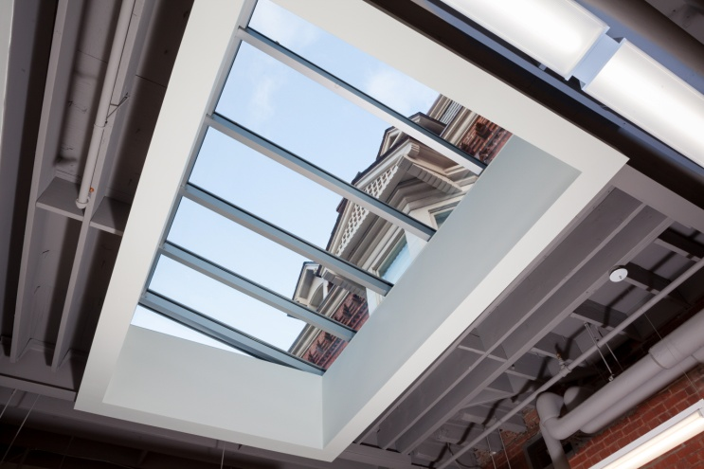
Some of our work
Bloomfield College Center for Technology+Creativity
Before
Entry Lobby
Fallon+Pacheco Architects

Slide 23
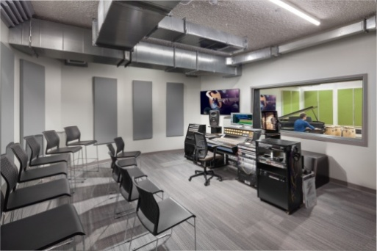
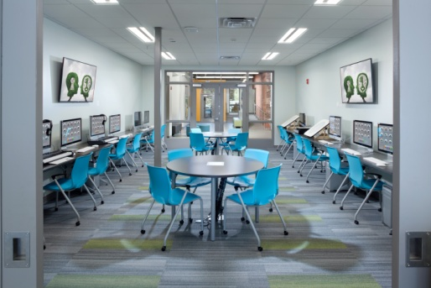
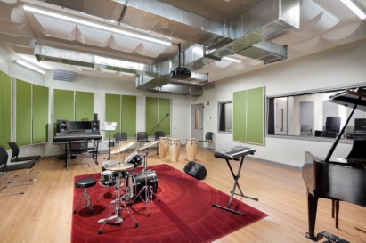
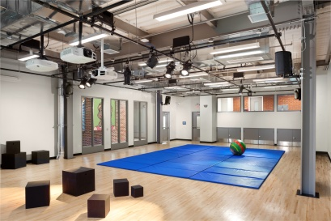
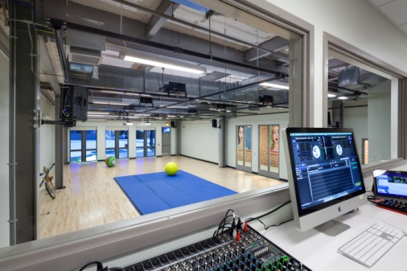
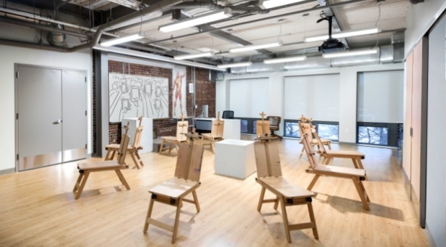
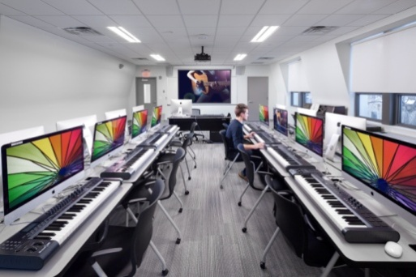
Some of our work
Bloomfield College
Center for Technology+Creativity
Interior Spaces
Fallon+Pacheco Architects

Slide 24
Fallon+Pacheco Architects

Slide 25
Thank You!
Fallon+Pacheco Architects

