Slide 1


P.S. 21 Paterson NJ
Andrew E. Thompson AIA NOMA Passaic County Architect

Slide 2
Where do I come from?
Born Belize Central America
Raised in Brooklyn New York
Entire education from kindergarten through high school was in the NYC Public School system
Andrew E. Thompson AIA NOMA Passaic County Architect

Slide 3
Why
Did I want to be an Architect
I loved to draw- comics, then spaceships, then moon colonies
I liked to build model kits, planes, ships, cars, etc.
I always liked fixing things
In high school I took a shop class that taught designing a wood frame house at ¼” scale- I WAS HOOKED!
Andrew E. Thompson AIA NOMA Passaic County Architect

Slide 4
How
do you become an Architect
College Degree in Architecture – Bachelor or Masters
Register experience as an Intern through AXP
Take and pass a state licensing exam
Andrew E. Thompson AIA NOMA Passaic County Architect

Slide 5
What you Need
to study Architecture
First, every college and university is different
Math
Art, design and drawing
Physics
Science
History
Andrew E. Thompson AIA NOMA Passaic County Architect

Slide 6
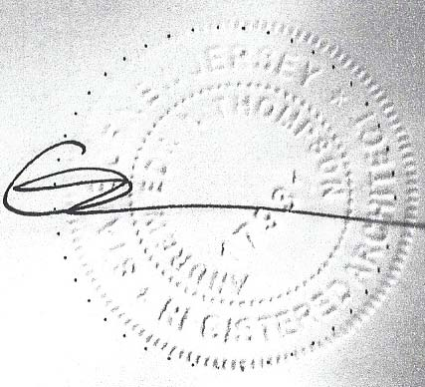
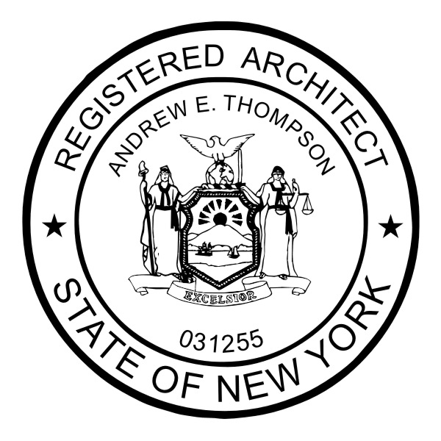

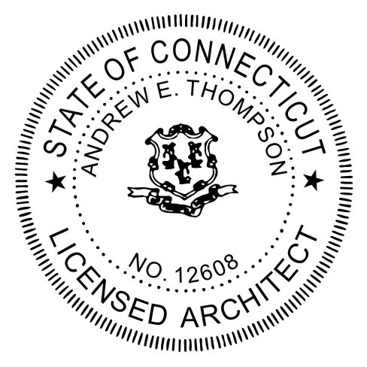
NJ
NY
NC
CT
Andrew E. Thompson AIA NOMA Passaic County Architect

Slide 7

MineCraft

Slide 8


Slide 9
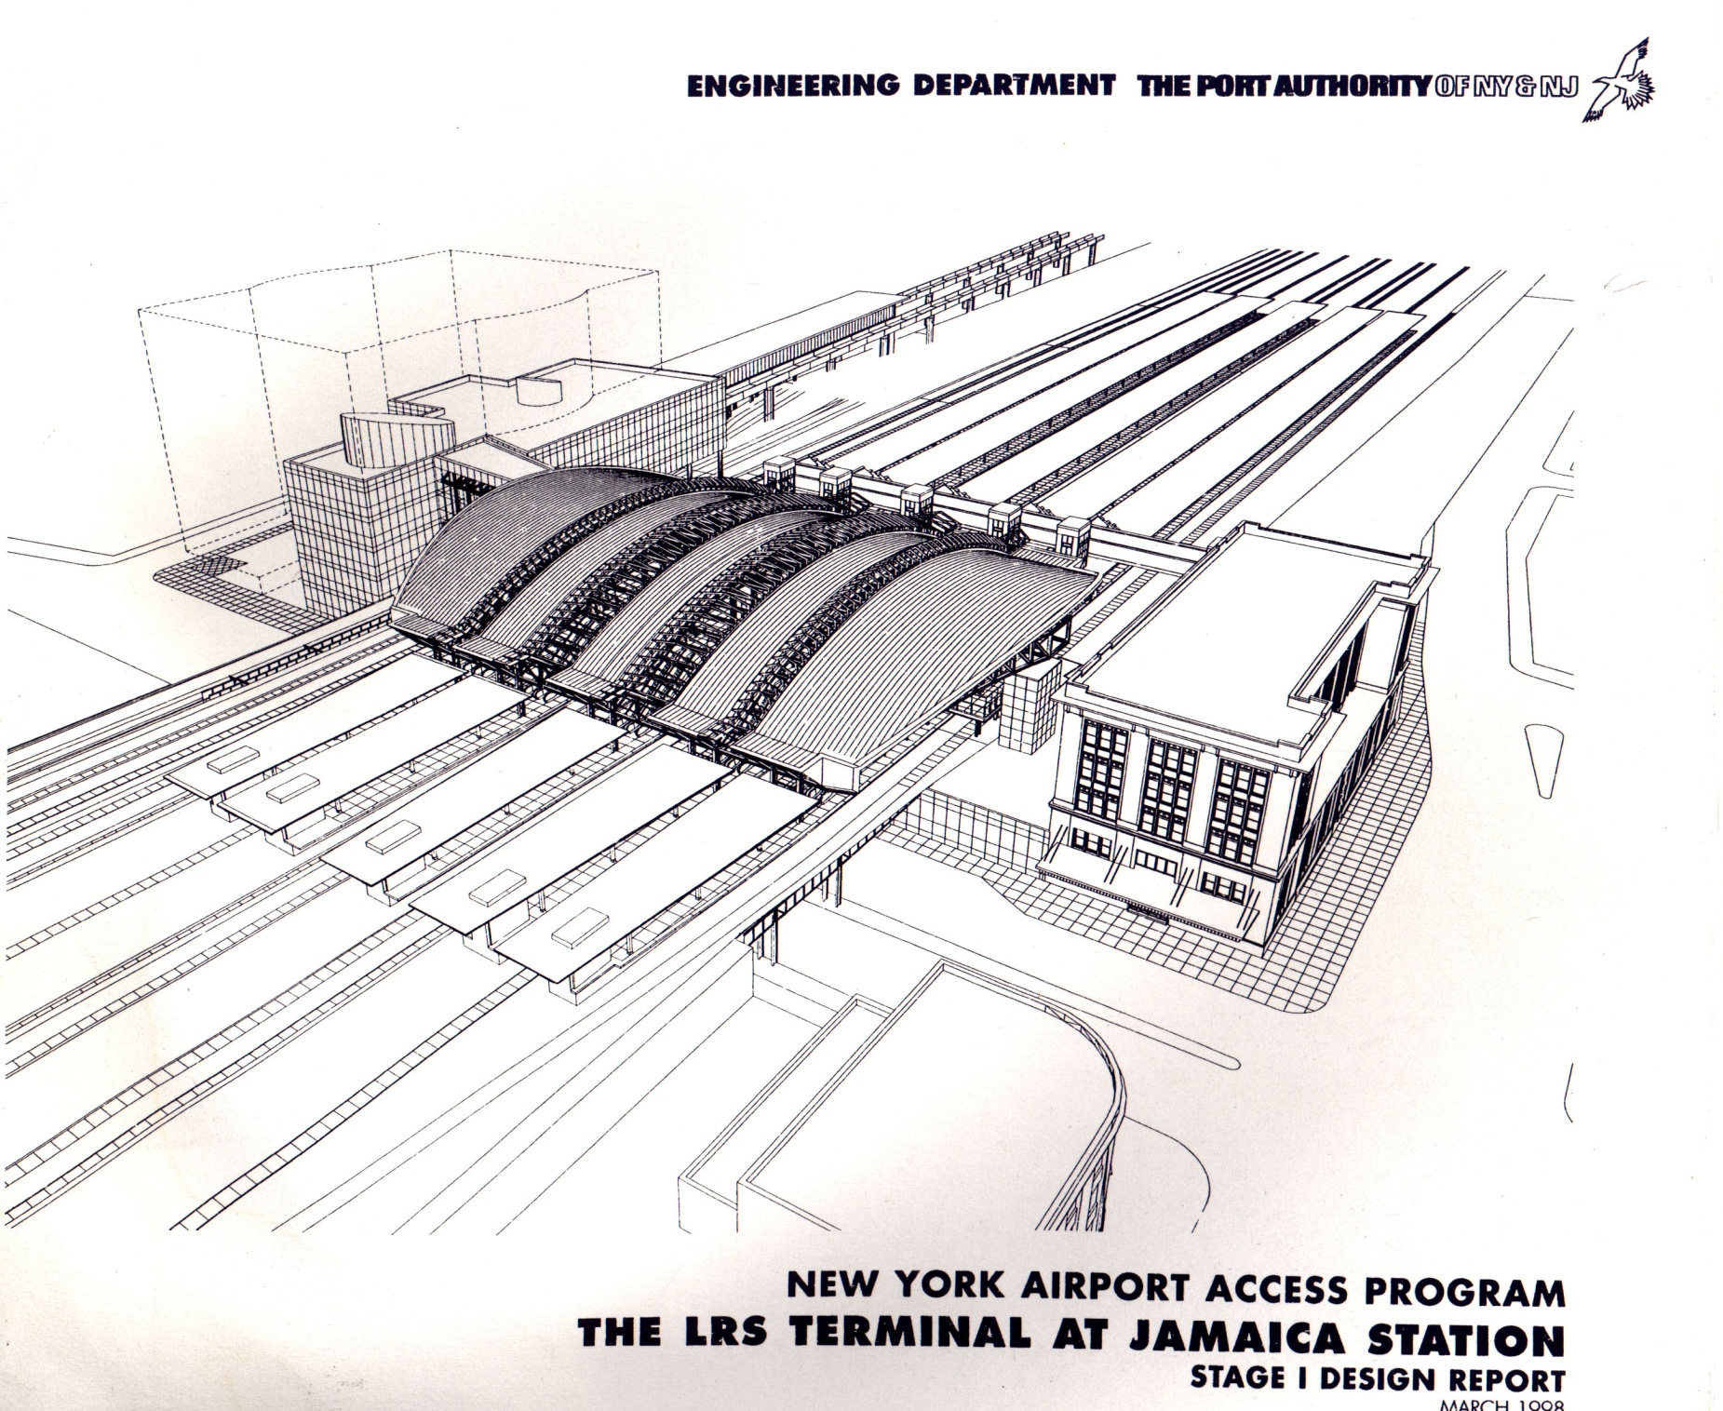
MARCH 1998

Slide 10
AirTrain- Long Island Railroad Connection PANYNJ

Slide 11
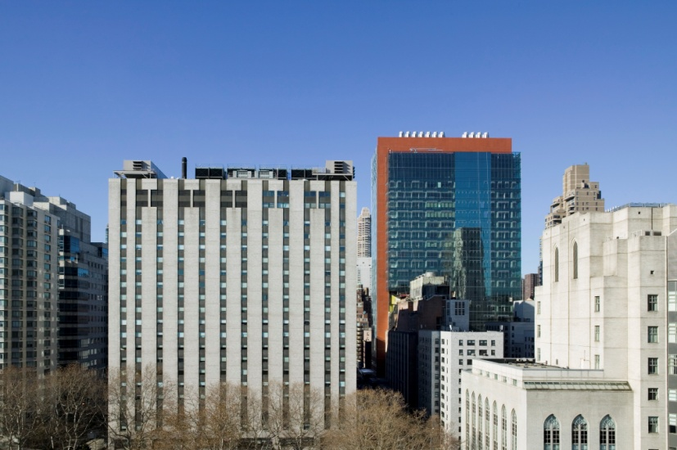
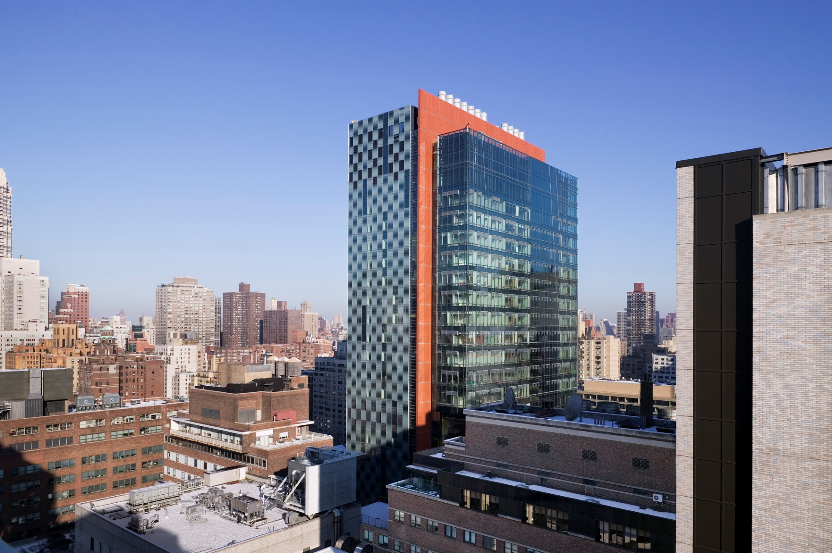
DESIGN INNOVATION
Research Lab Building
Sustainable design
Memorial Sloan-Kettering Cancer Center NYC NY

Slide 12
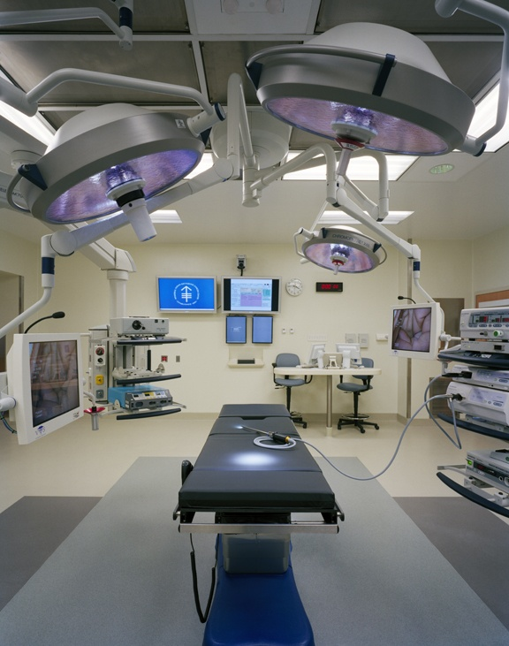
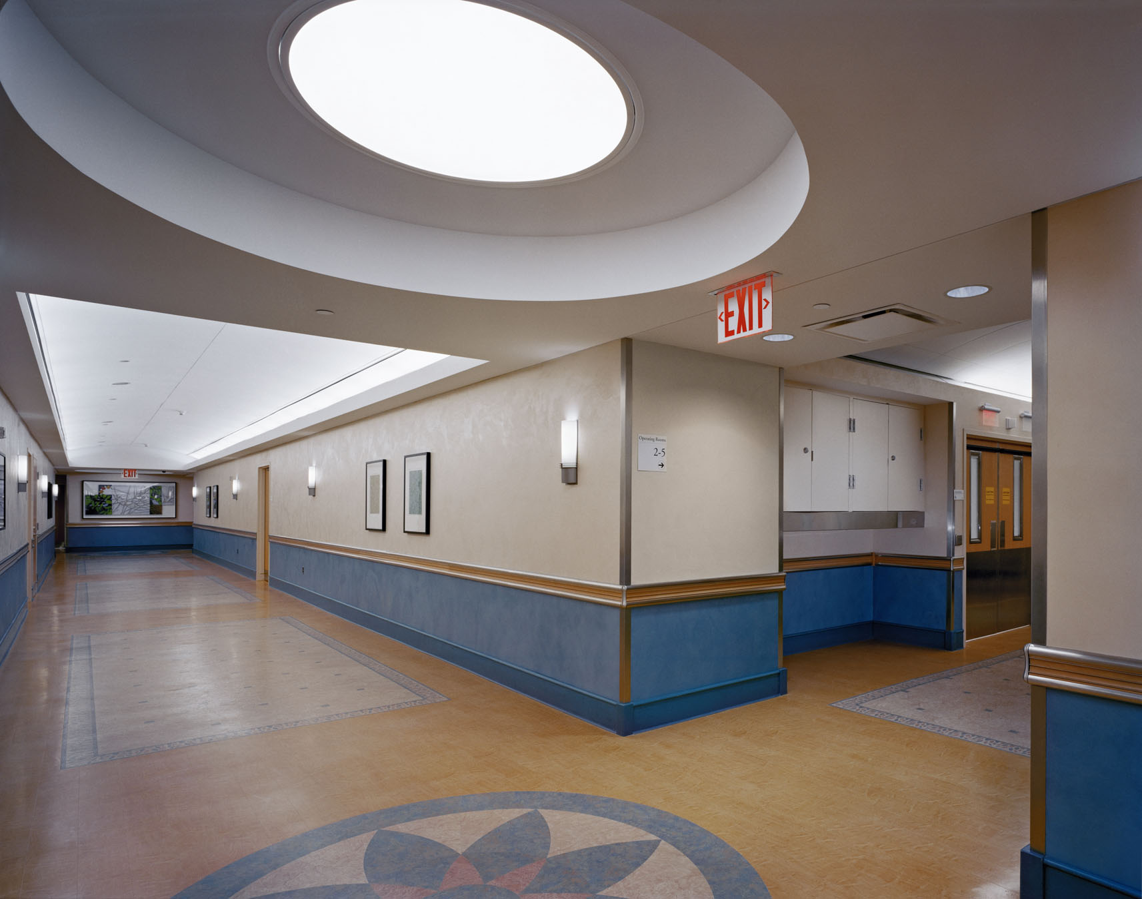
OR CASE STUDY- MSKCC
Memorial Sloan-Kettering Cancer Center NYC NY

Slide 13
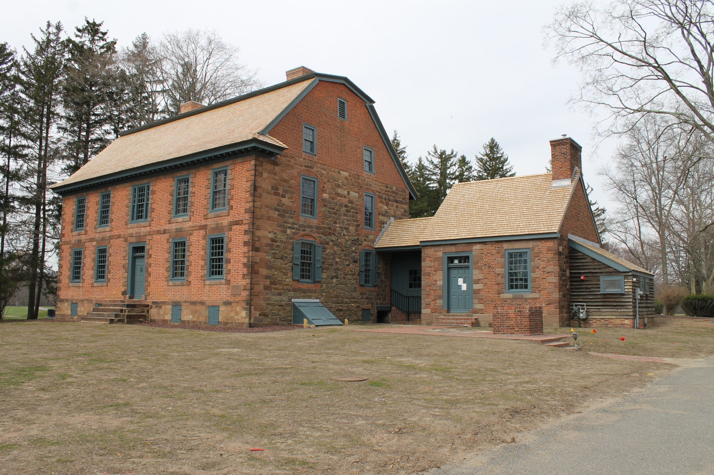
Dey Mansion- Wayne NJ
Historic Renovation
Andrew E. Thompson AIA NOMA Passaic County Architect

Slide 14
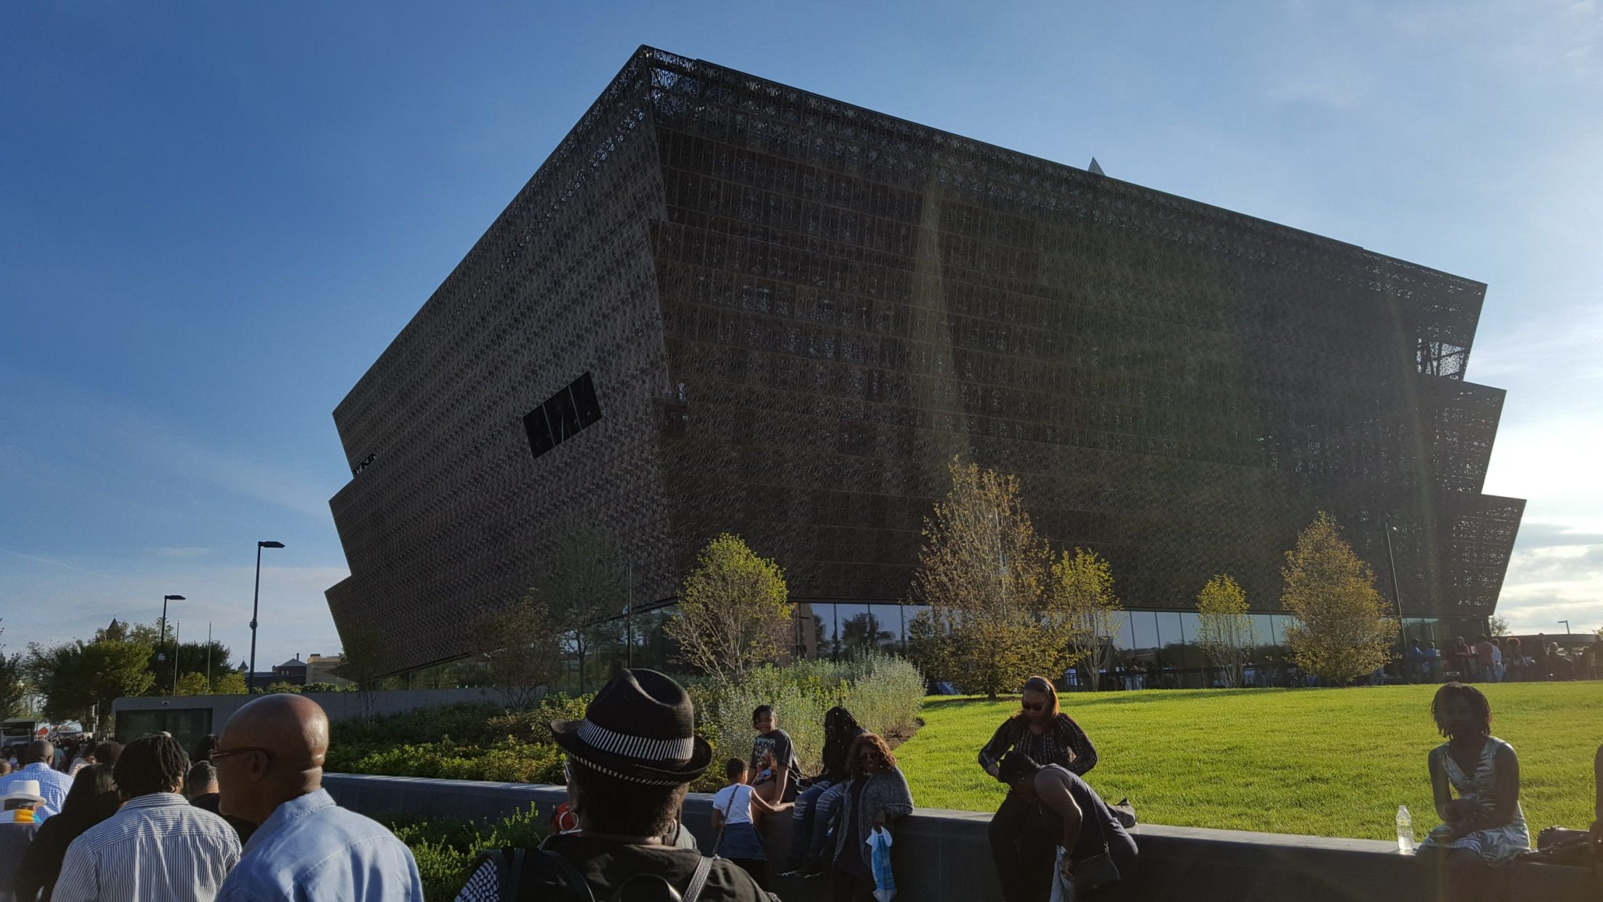
National Museum of African American History and Culture
Washington DC

Slide 15
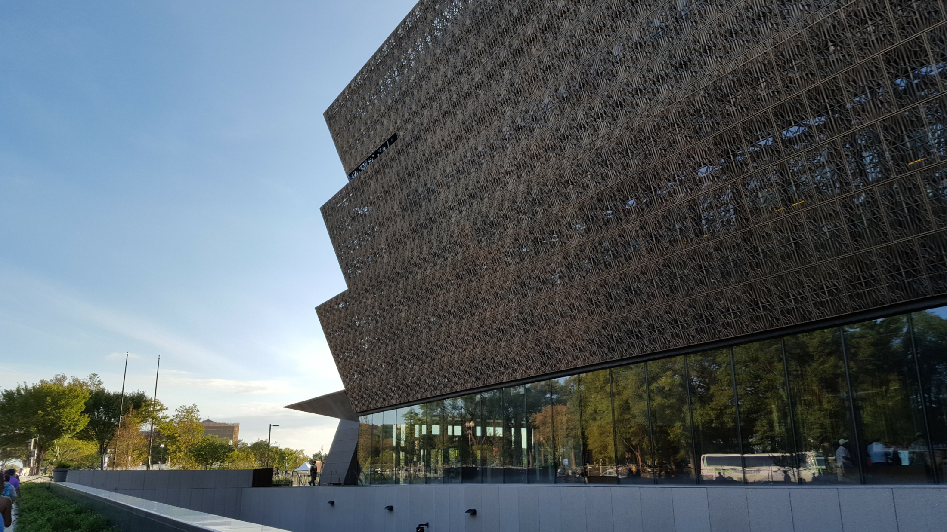
National Museum of African American History and Culture
Washington DC

Slide 16
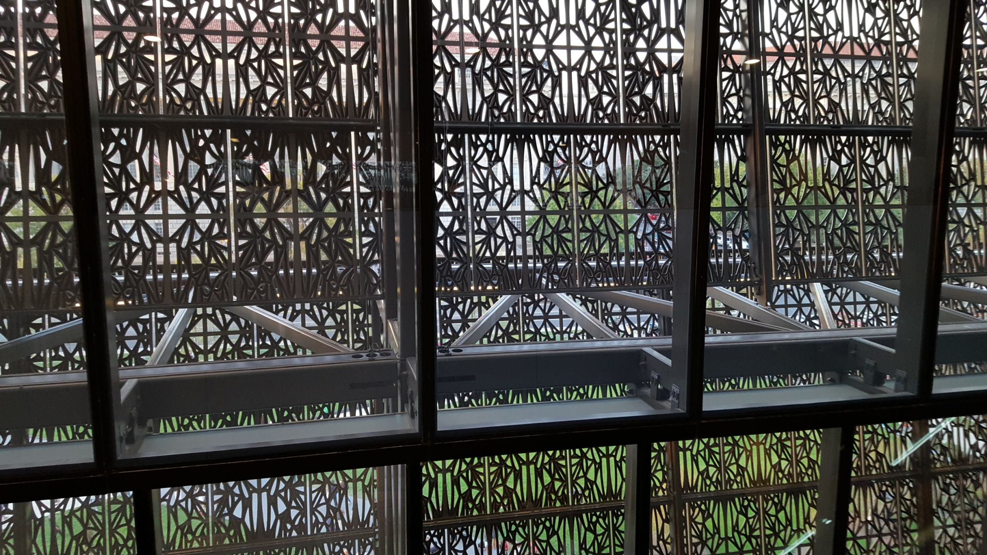
National Museum of African American History and Culture
Washington DC

Slide 17
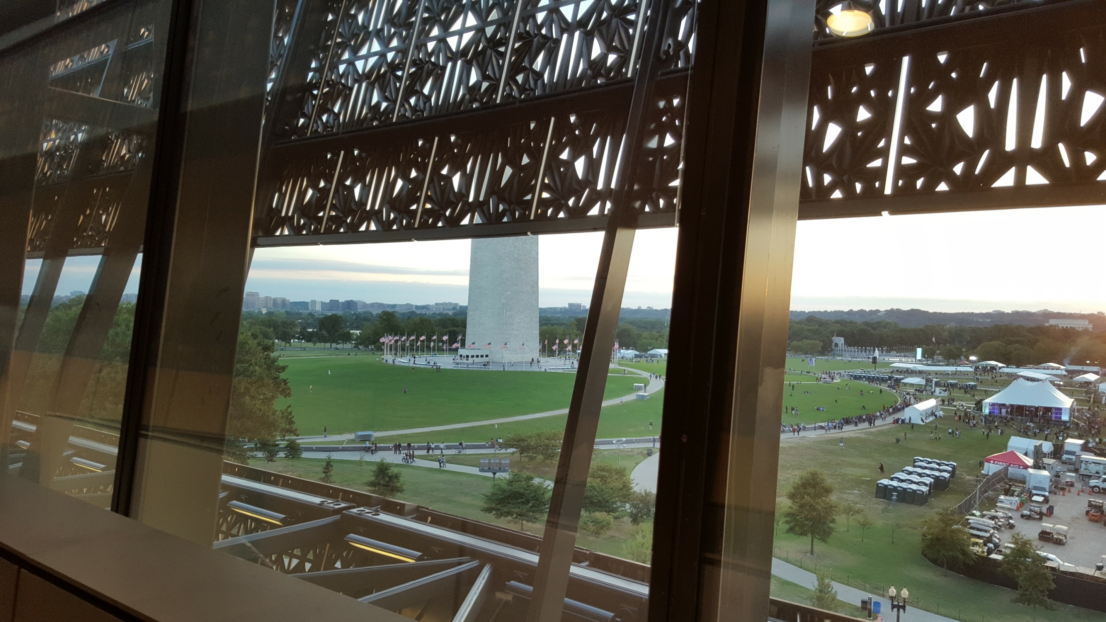
National Museum of African American History and Culture
Washington DC

Slide 18
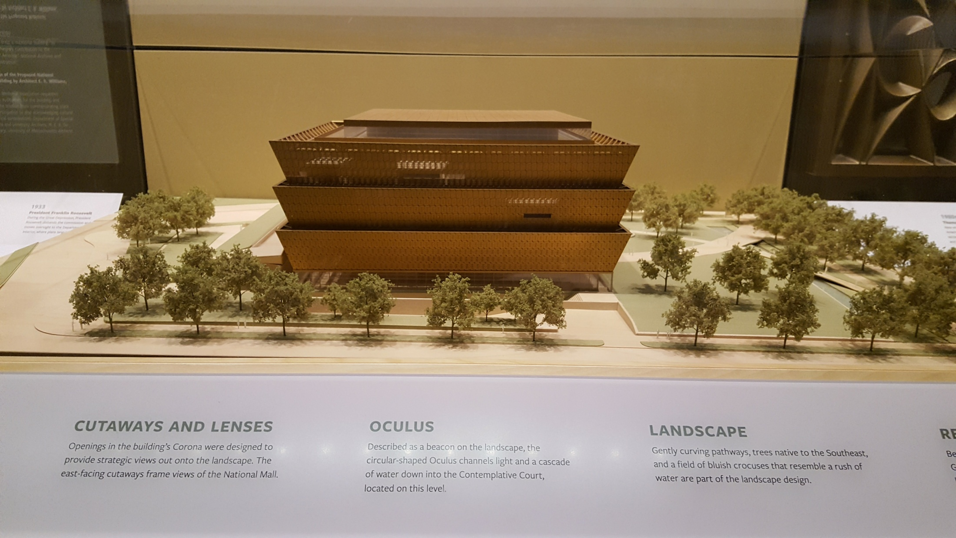
National Museum of African American History and Culture
Washington DC

Slide 19
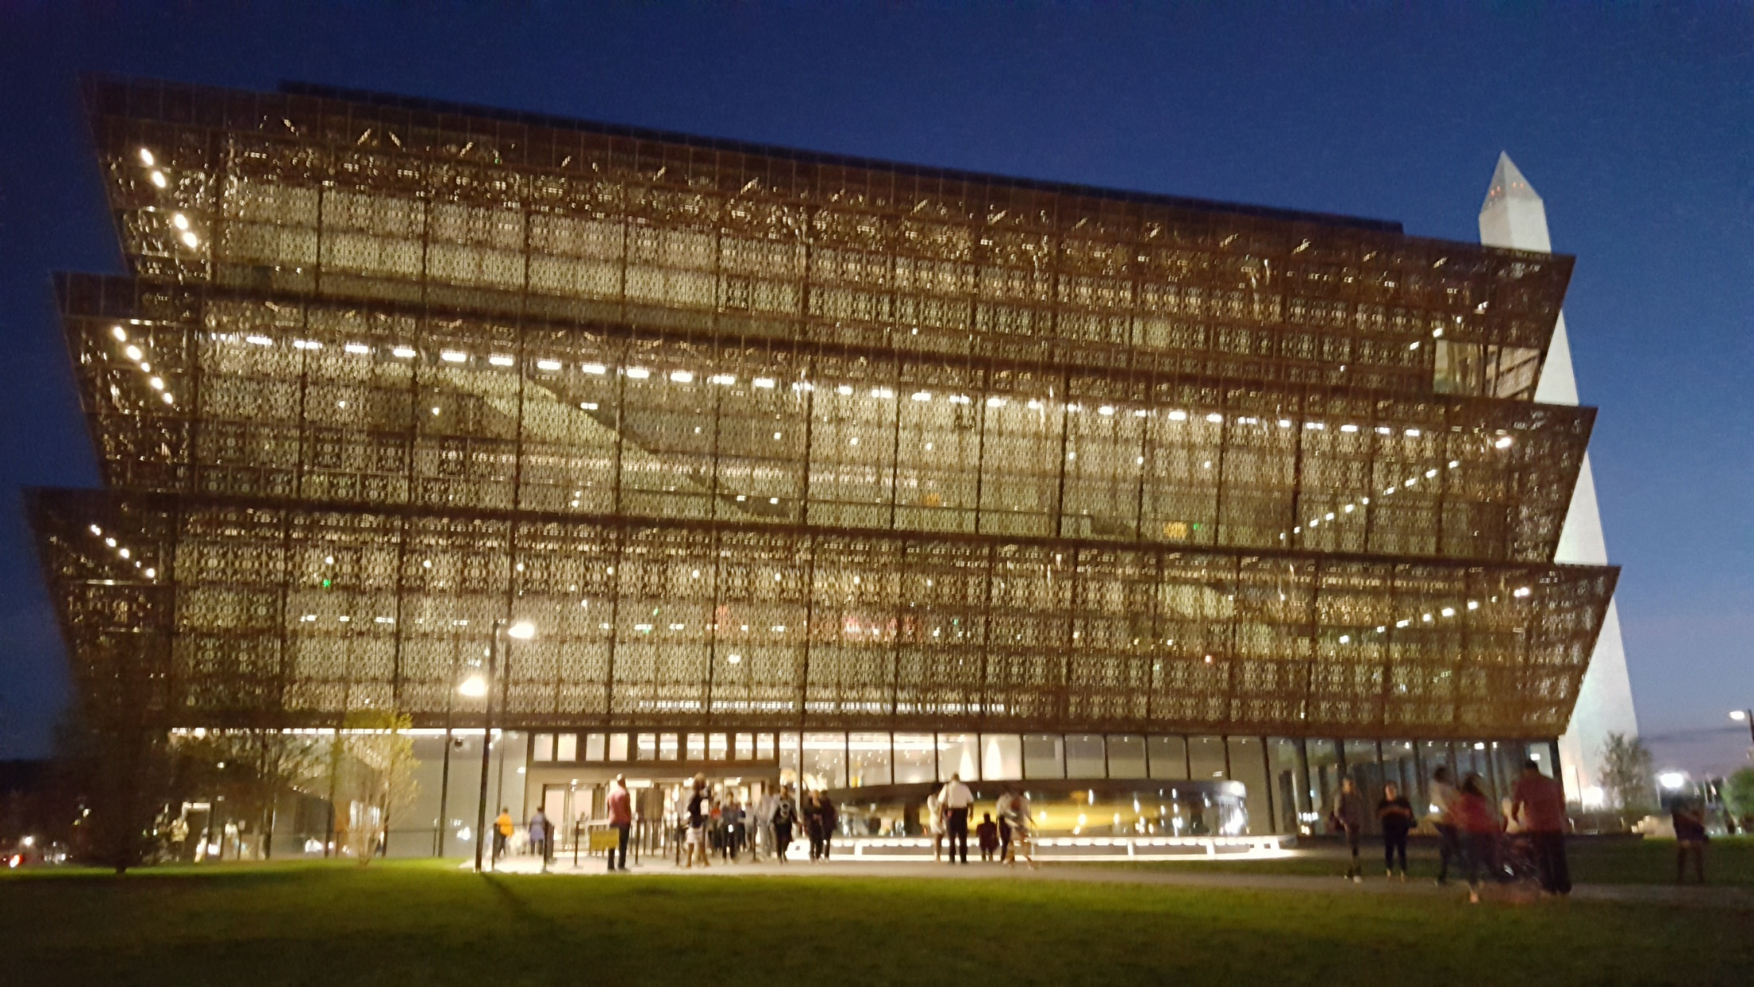
National Museum of African American History and Culture
Washington DC

Slide 20
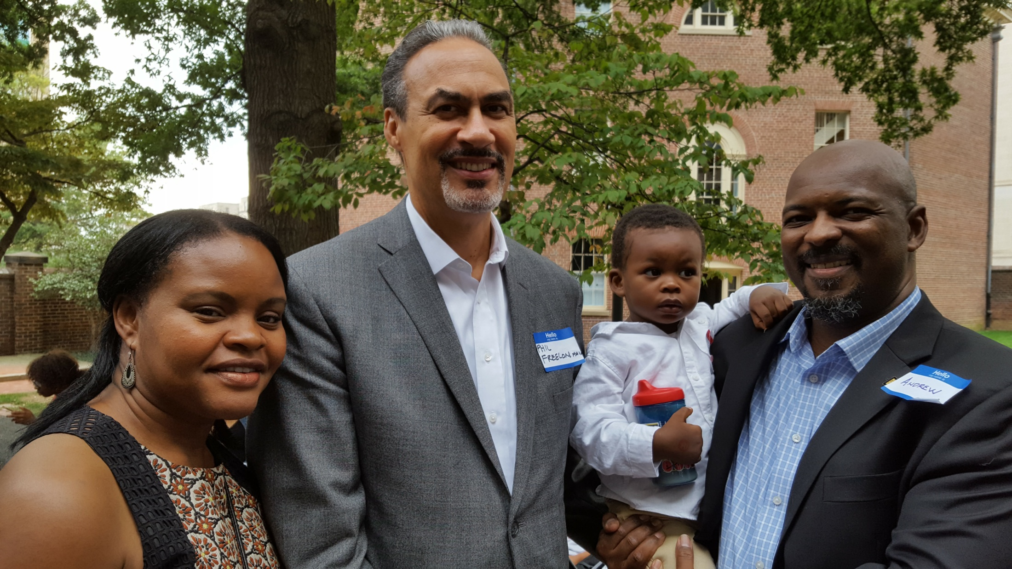
National Museum of African American History and Culture
Washington DC
Phil Freelon FAIA NOMA NMAAHC Architect

Slide 21
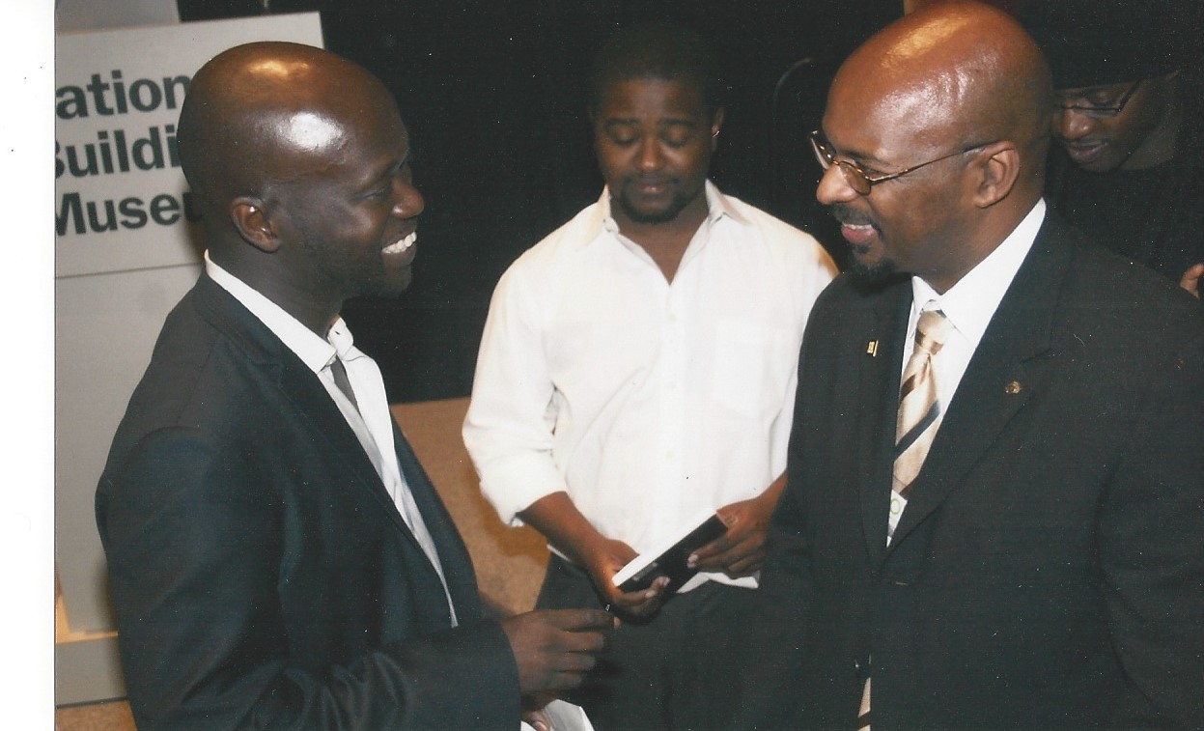
Sir David Adjaye RIBA NMAAHC Design Architect

Slide 22
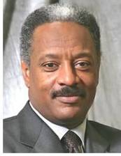
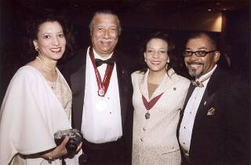
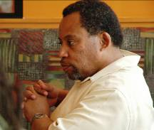
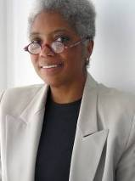
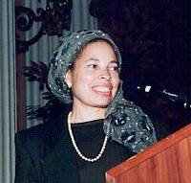
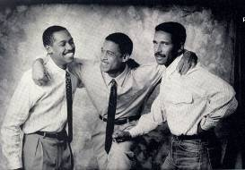
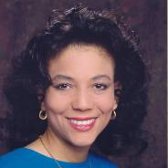
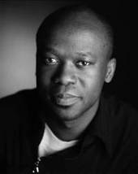
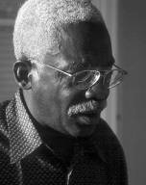
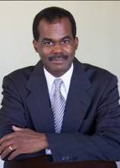
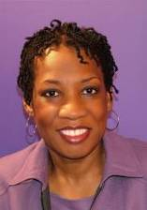
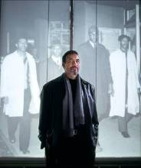
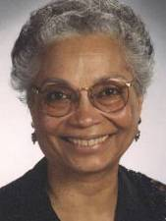

N.O.M.A – National Organization of Minority Architects

Slide 23
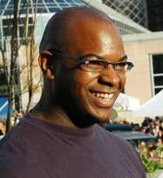
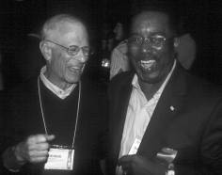


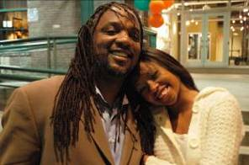
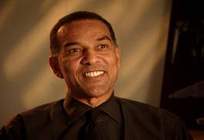

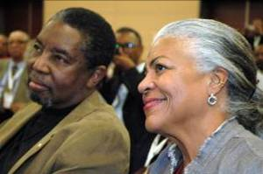
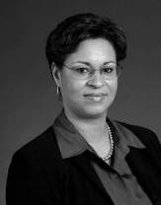
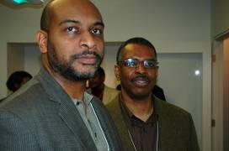
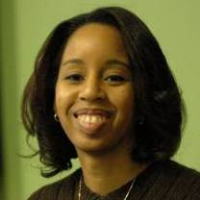
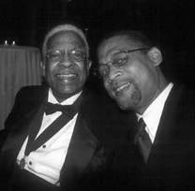
N.O.M.A – National Organization of Minority Architects

Slide 24

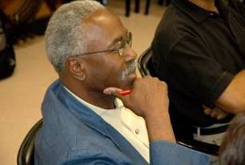
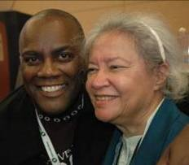
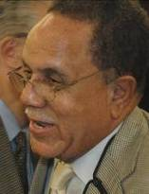
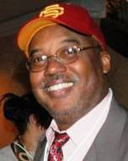
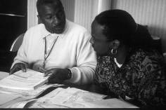
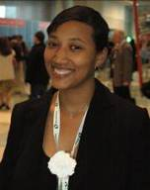
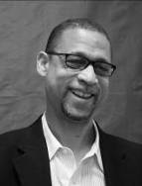

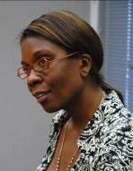
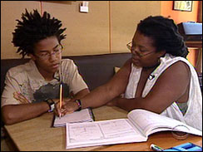
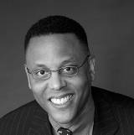
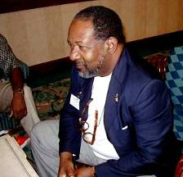

N.O.M.A – National Organization of Minority Architects

Slide 25


Only 2% of licensed architects are black
431 Female
1776 Male
2207 Total Licensed Black Architects
* Data as of May 2018

